Slide 1
Day One at Student Affairs
Presented by Matt Pendleton

Slide 2
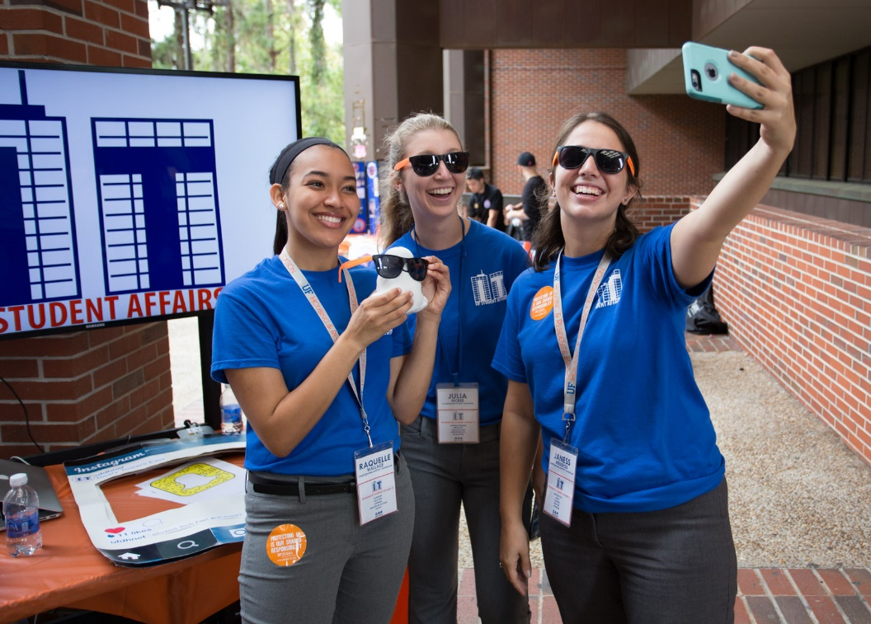
Who is Student Affairs?
Career Resource Center
Center for Leadership & Service
Counseling & Wellness Center
Dean of Students Office
Machen Florida Opportunity Scholars
Gatorwell Health Promotion Services
Housing & Residence Education
J. Wayne Reitz Union
Multicultural & Diversity Affairs
Off Campus Life
Recreational Sports
Student Activities & Involvement
Student Government
Student Legal Services

Slide 3

Who is Student Affairs?
Career counseling & placement
Student Organiziations including Sororities & Fraternities
Orientation for new students
Parents and Families of students
Student Emergencies and Deaths
Multicultural and Diversity Affairs
Counseling and Behavioral issues
Student conduct, Healthy behavior, Alcohol policies
Student Government
Student Leadership/community service
Housing & Residence Education
Intramurals, fitness, & sport clubs

Slide 4
What is the “Day One” Initiative?

Slide 5
What is the “Day One” Initiative?
One Simple Goal
Reduce frustration with any IT system on an employee’s first day of work at any of our departments for any type of employee (student, staff, etc.)

Slide 6
How “Day One” is Accomplished

Slide 7
How “Day One” is Accomplished
Communication from IT to all departments on a reoccurring basis
Monthly to Bi-Monthly IT Collaboration Meetings
Established SLAs with each department
Workshops with each department before signing and agreeing
Work with HR/Identity Coordinators in each department to alert IT when they are ready to hire
In many cases, we know of new hires weeks in advance of their arrival
Ask for any changes on IT needs

Slide 8
How “Day One” is Accomplished
Online Web App for IT Service Access Requests
Interfaces with UFSA Active Directory to pull the exact names of security groups/distribution groups, shared drives
Request form adjusts based on submitter’s department
Ex: Housing has different questions than Multicultural & Diversity Affairs
Users enter UFID, choose a display name, then select access
Has option for bulk submission, saving time for users of the same access type
Templates built by job title to save time
Prefilled to include common access rights

Slide 9
How “Day One” is Accomplished
New Employee IT Services User Guide sent to employee, supervisor, and hiring authority at least 48 hours prior
Document is a PDF file
PDF also placed in their personal network shared drive
Includes:
Email setup for mobile phones
Mailmeter training
Commonly encountered IT policies
View our guide here
https://it.ufsa.ufl.edu/documents/ufsait-newemployee-itservicesmanual.pdf

Slide 10
How “Day One” is Accomplished
Computer is imaged & encrypted with a clean OS install for each new employee
Setup on location a business day before employee start date
Reduces common issues
All computers (desktop/Laptop) are encrypted in Student Affairs
Use PowerShell to more accurately map network drives and printers using security groups
One Excel file controls drive and printer mapping for each department
File Enumeration makes assigning shares easier
Users only see the folders for which they have access

Slide 11
IT Assistance on “Day One”

Slide 12
IT Assistance on “Day One”
IT Assistance contact information is on all login screens for easy reference
Image is set via Group Policy
For Key Stakeholders/Positions we will normally have an IT Assistance staff person on-site for help
Departments request this service
Additional Employee Training available upon request
Housing Learning & Development staff plus IT Staff provide training for most services
Constant Improvement
We work with each department almost immediately whenever there is an issue
Helps prevent issue from reoccurring

Slide 13
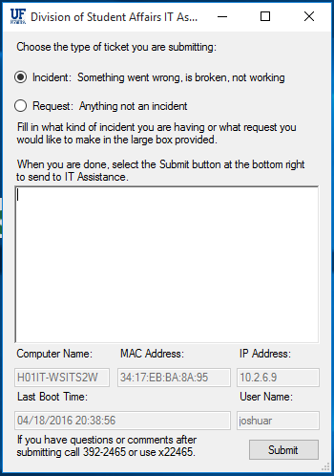
IT Assistance on “Day One”
IT Assistance application on all desktops
Grabs required support technical information
allows employee to submit either a Request or Incident all in one step
PowerShell GUI app
Built using PowerShell Studio 2016

Slide 14
Current Issues with “Day One”

Slide 15
Current Issues with “Day One”
Not being notified of employee’s start date
Employees also sometimes start earlier
Computer does not have right software installed
We may not get notification from supervisor in time
Full access requirements are not listed or submitted by supervisor on time
Supervisors are not present on employee first day
New Employees may not check their email in time

Slide 16
What Can You Do Now?

Slide 17
What can you do now?
Start up a conversation with your hiring authorities
How can IT be part of that process?
Establish Service Levels (or start an SLA) with your customers
Requires meetings with your customers
What level of service can you consistently offer?
Create a User Manual/Training Guide for your customers
What are commons questions?
How do your customers contact your for help?
What IT Services do your customers need to do their job?
Promote those services
Don’t Know? Ask them
How easy is it for your customers to request IT Services?
Can changes be made to improve that process?

Slide 18

QUESTIONS?
More Information, Please Contact Us
Matt Pendleton
mattp@ufsa.ufl.edu
(352) 392-2171 x10107
Learn more about Student Affairs IT
https://IT.UFSA.UFL.EDU

