Slide 1

ALONE
Alone we can do so little;

Slide 2

TOGETHER
together we can do so much.
– Helen Keller

Slide 3

GITHUB IS COLLABORATION & COMMUNITY
SHARE
CONTRIBUTE
HELP
GET HELP

Slide 4
BEFORE GITHUB WHY GIT?
1
2
3
4
Multiple People
Modularity
Time Travel
Work Offline

Slide 5



MULTIPLE PEOPLE

Slide 6
MULTIPLE PEOPLE
Multiple people can work on the same file at the same time without hosing each others work
Leads to greater productivity ( more people ), and quality ( more eyes )

Slide 7

MODULARITY/BRANCHES

Slide 8
MODULARITY/BRANCHES
FEATURES
EXPERIMENTS
BUGS

Slide 9

FEATURES MODULARITY
FEATURE C
FEATURE D
FEATURE B
FEATURE A

Slide 10
FEATURES MODULARITY
Break problems into manageable features
Easily switch between features
Feature A is no longer desired; Delete it
Feature B is impossible; Delete it
You totally screwed up feature C; Delete it

Slide 11

Experiments MODULARITY

Slide 12
Experiments MODULARITY
Test any idea without fear of jacking up your project
Try multiple approaches to the same problem and keep the best

Slide 13

BUGS MODULARITY

Slide 14
BUGS MODULARITY
You can squash a bug with multiple features or experiments in development

Slide 15
MODULARITY IN REVIEW
Eliminates the need for index.html, index2.html, index3.html
Makes it less likely unfinished work will accidentally mix-in with production code
Leads to greater productivity and quality

Slide 16

TIME TRAVEL

Slide 17
TIME TRAVEL
Go back to any point in the history of development and review or restore code
Remember what and why you did something in the past or in the present

Slide 18

WORK OFFLINE

Slide 19
WORK OFFLINE
On a plane, at the doctor's office, or waiting in the car
Since Git is distributed you always have a backup of the entire history of your project

Slide 20
WHY GIT? IN REVIEW
1
2
3
4
5
Multiple People
Modularity
Time Travel
Work Offline
Productivity
& Quality

Slide 21
WHY GITHUB?
01
Security
04
Access (collaboration)
02
Hosting (adoption)
05
Communication
(collaboration)
03
Web Interface (adoption & collaboration)
06
Collaboration

Slide 22

SECURITY FEATURE

Slide 23

SHIB, AD, 2FA SECURITY

Slide 24
SHIB, AD, 2FA SECURITY
Authorization for Github Enterprise is SAML/Shibboleth or Active Directory
Login for Github off prem can use 2FA
If you are currently using Github particularly with Facebook or Gmail credentials then you may want to turn on 2FA

Slide 25

UF SERVERS SECURITY

Slide 26
UF SERVERS SECURITY
Data is stored on UF machines
Can use private IP’s

Slide 27

AUDITABLE SECURITY

Slide 28
AUDITABLE SECURITY
If all code is in one place then it is auditable by people and by scripts

Slide 29


PRIVATE DATA SECURITY
123456
PASSWORD

Slide 30
PRIVATE DATA SECURITY
Ensure passwords and other sensitive data are not hosted all over the place
Within an organization or Github Enterprise you can make most of your projects public since only other UFIT citizens can see the code

Slide 31
AFRAID SECURITY
No means not comfortable hosting
code on Github.

Slide 32
AFRAID SECURITY
Many people need the features of Github but are uncomfortable hosting code on non UF servers
This kills collaboration opportunities

Slide 33

GIT HOSTING FEATURE

Slide 34
GIT HOSTING FEATURE
Lowers barriers to entry skill wise
Makes adoption more likely
If its too difficult people won’t use version control

Slide 35

ACCESS FEATURE

Slide 36
ACCESS FEATURE
Lowers barriers to collaboration
If its too difficult people won’t collaborate

Slide 37

WEB INTERFACE FEATURE

Slide 38
WEB INTERFACE FEATURE
View your code from any device/location
Every line is a reference for a future need
Total transparency
See the history of everything
Crazy good collaboration tools
Crazy good communication tools

Slide 39
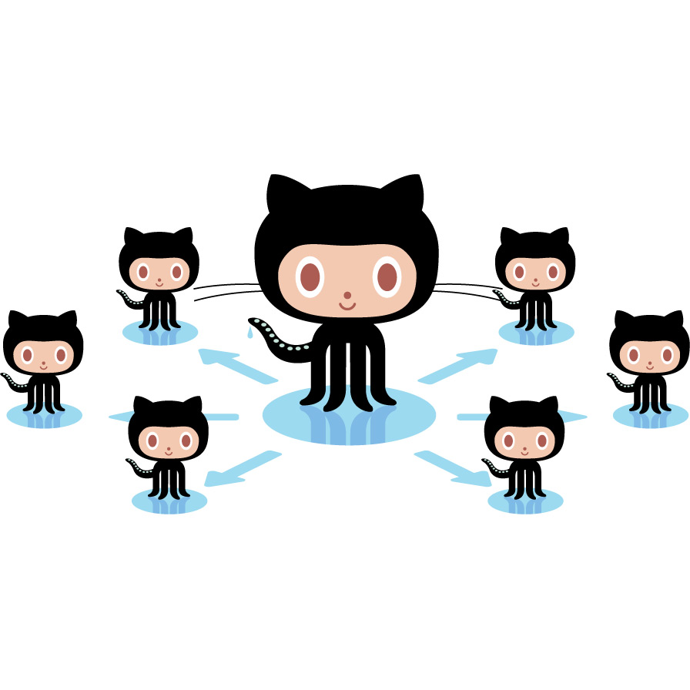
COMMUNICATION FEATURE

Slide 40
COMMUNICATION FEATURE
ISSUES & LABELS
CODE REVIEW
MILESTONES
COMMENT & DISCUSS
MARKDOWN
WIKI
All project communication in one place!

Slide 41






COLLABORATION FEATURES
FORK
COMMITS
CODE REVIEW
BRANCH
PULL REQUEST
MERGE
GitHub Flow / Feature Branch Workflow

Slide 42
FORK FEATURE

Slide 43
FORK FEATURE
You take a project you don’t have write access to and make a copy of it under your own account so you can modify it
Fork a project to work on features or bugs
Fork a project to get a head start on your own project

Slide 44
COMMIT GIT FEATURE

Slide 45
COMMIT GIT FEATURE
A batch of code changes to one or more files with a message describing the changes made

Slide 46
BRANCH GIT FEATURE

Slide 47
BRANCH GIT FEATURE
A parallel copy/snapshot of your project
This is where you develop a feature
This is where you squash a bug
This is where you experiment

Slide 48
PULL REQUEST FEATURE

Slide 49
PULL REQUEST FEATURE
A notification to the original owner that you have completed a feature or bug fix

Slide 50
CODE REVIEW FEATURE

Slide 51
CODE REVIEW FEATURE
The original owner of the project can perform a code review on your feature or bug fix, add comments, make commits, or requests additional changes

Slide 52
MERGE GIT FEATURE

Slide 53
MERGE GIT FEATURE
After the pull request and code review the original owner can merge your feature or bug fix into the original project
Yay for progress ( hello new feature or goodbye bug )

Slide 54
COLLABORATION FEATURES
FORK
COMMITS
CODE REVIEW
BRANCH
PULL REQUEST
MERGE
GitHub Flow / Feature Branch Workflow

Slide 55
UF GITHUB
MOST UF PROJECTS OPEN SOURCED
CODE ACCESSIBLE TO ALL UFIT WORKERS
CODE CLOSED TO ALL NON UFIT WORKERS
UNLIMITED COLLABORATION OPPERTUNITIES

Slide 56
WHY GITHUB?IN REVIEW
ADOPTION OF VERSION CONTROL
SECURITY
COMMUNICATION
COLLABORATION
PRODUCTIVITY + QUALITY

Slide 57

GIT SMARTER
http://adriangritz.github.io/git-real-presentation/

Slide 58
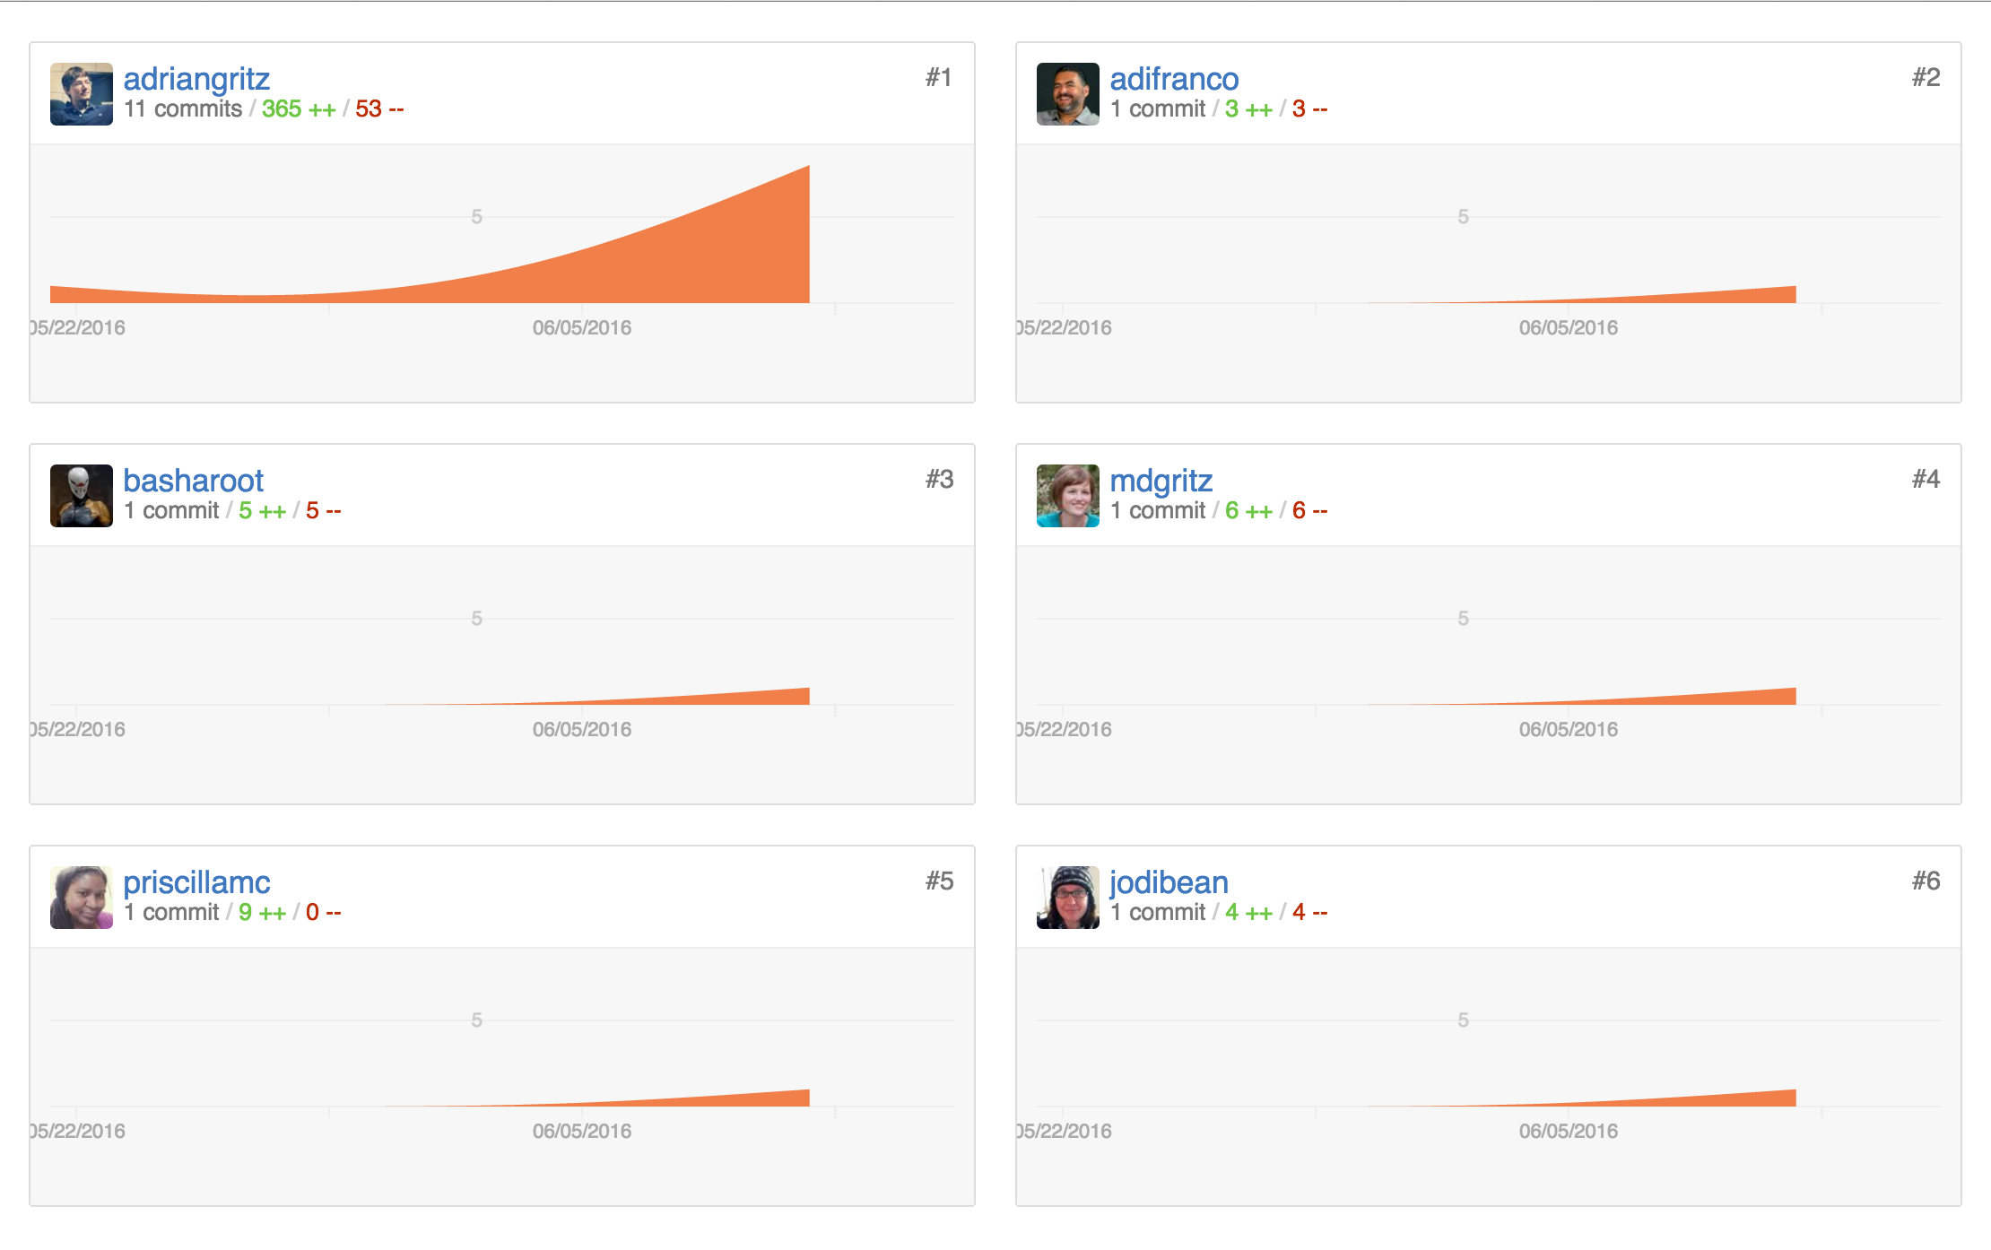
THANK YOU GIT SMARTER CONTRIBUTORS

Slide 59

DATA

Slide 60
WORLD POPULARITY
63
800
4,656
Gitlab
Bitbucket
Github

Slide 61
GIT HOSTING

Slide 62
GIT vs SVN

Slide 63
GIT GUI

Slide 64
COMPANIES USING GITHUB
GOOGLE
OPEN SOURCE
MICROSOFT
US GOV
APPLE

Slide 65
GITHUB FOR ENTERPRISE SURVEY RESULTS
GITHUB FOR ENTERPRISE
EXISTING CODE STORAGE
OKAY HOSTING ON GITHUB

Slide 66
GITHUB FOR ENTERPRISE

Slide 67
CODE STORAGE

Slide 68
OKAY HOSTING ON GITHUB

Slide 69
OPINIONS FROM PEOPLE WHO CARE
01
I like this.
04
This topic is the first useful thing I have seen on yammer.
02
Love the potential networking and sharing of creativity.
05
This would be a welcome resource for code-sharing in and among UF projects.
03
This would greatly benefit all of UFIT and would be worth any expense.
06
I think it is short sighted for UFIT to not try to centralize and protect the code that is being written to conduct official UF business.

Slide 70

THE FUTURE
The future is not a place we go!

Slide 71


THE FUTURE CONTINUED
The future is a place we make!

Slide 72

CALL TO ACTION
Share the value of Git & Github with anyone and everyone!

Slide 73

CALL TO ACTION CONTINUED
Talk to your director! Talk to your friends! Share your opinions on yammer!

Slide 74

So we can tear down some walls…

Slide 75

and build some baller things together!

Slide 76

Thanks for BEARing with me until the end!

Slide 77

QUESTIONS?
Collaboration increases
Communication increases
Productivity & Quality increases
Security increases
Imagine we adopt Github

