Slide 1



Slide 2

Today’s Mixologist
JAMES KOCHER

Slide 3
OFFICE MIX
2 parts Microsoft PowerPoint
1 part Office 365
Splash of SCORM
Stir (Do NOT shake)

Slide 4

AGENDA
CREATING
BACK END
MANAGEMENT
LIMITATIONS
LTI (CANVAS)
INTEGRATION

Slide 5
CREATING
mix.office.com
mixforteachers.com
  teachers
  students
  adminstrators
  how-to

Slide 6
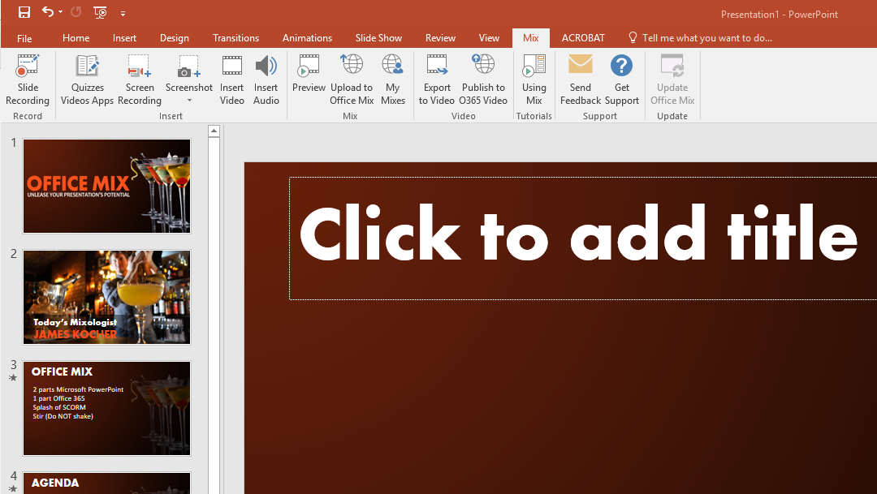

Slide 7
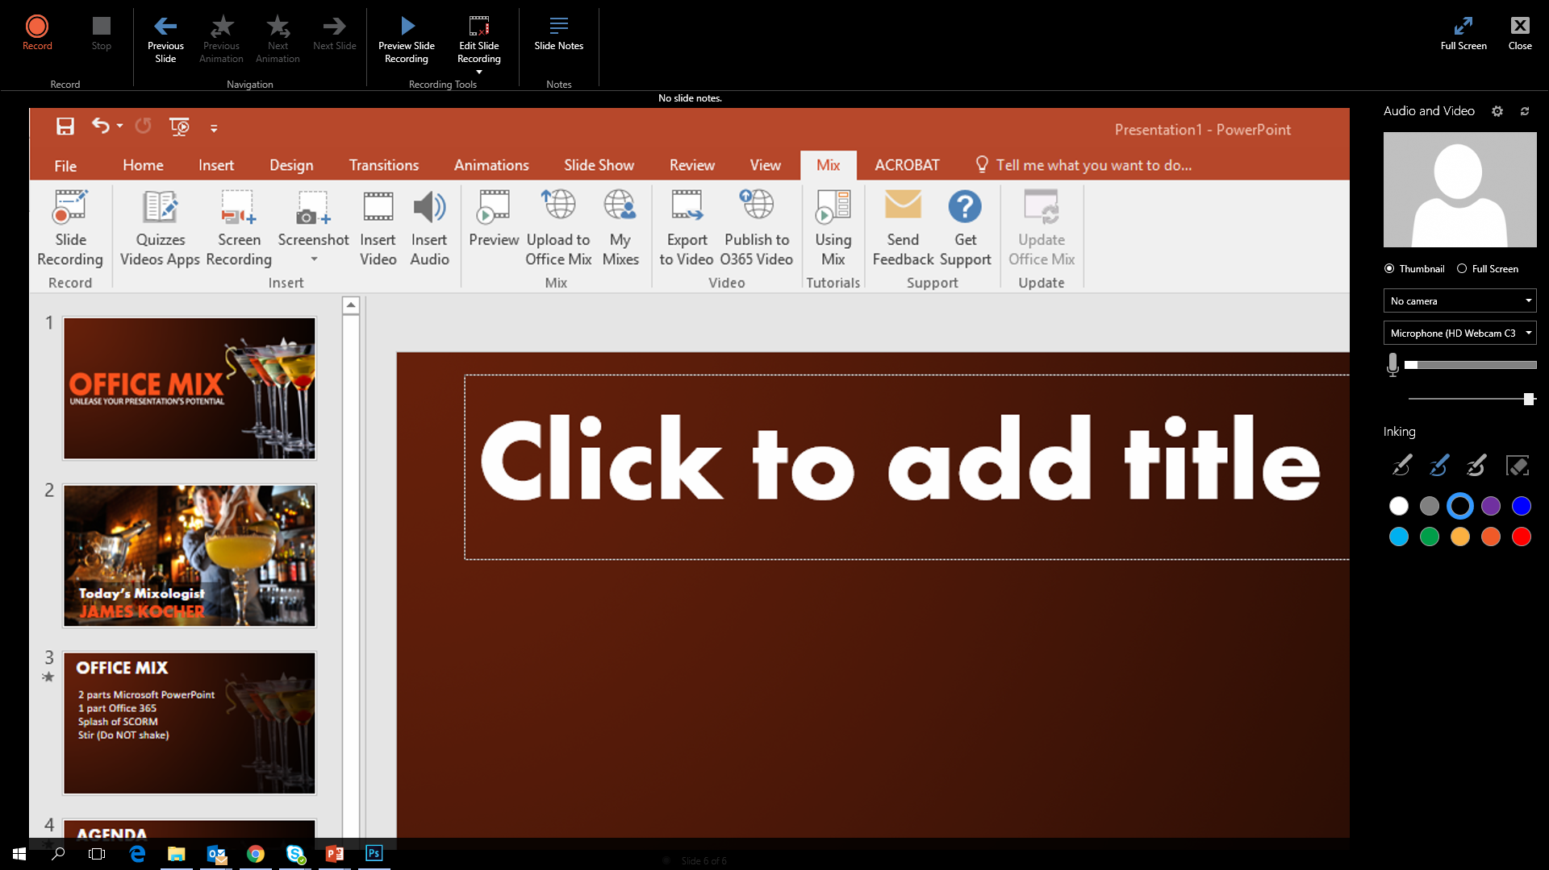

Slide 9
BACK END MANAGEMENT
mix.office.com

Slide 10
LIMITATIONS
ONLY 1 MULTIMEDIA
ELEMENT PER SLIDE
ANIMATED IMAGES
DON’T ANIMATE
DON’T END ON
A QUIZ QUESTION

Slide 11
LTI INTEGRATION

Slide 12
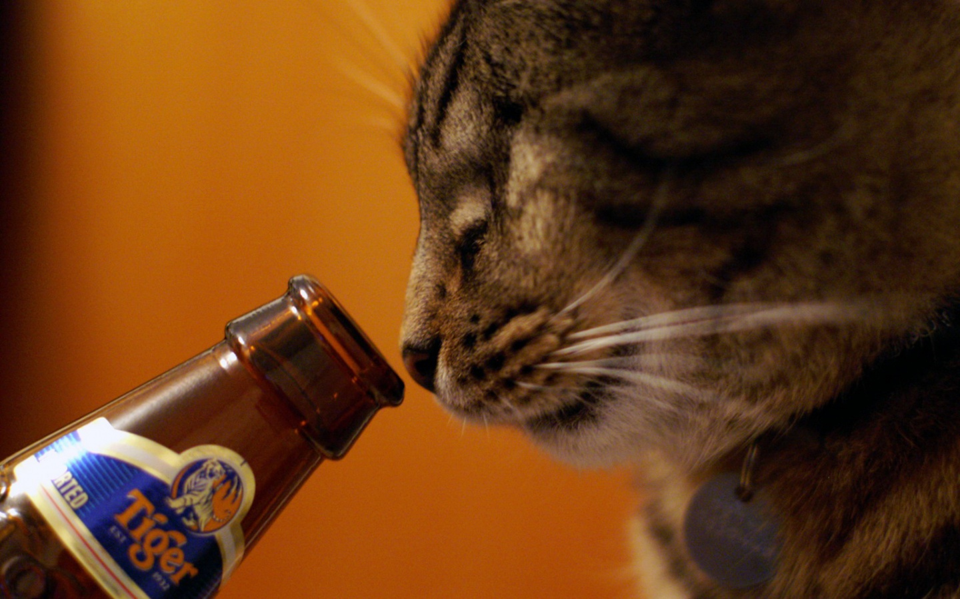

QUESTIONS?

