Slide 1
CITT Services
Center for Instructional Technology and Training
Stephanie McClelland
Associate Director
Peer to Peer
June 17, 2016

Slide 2
What We Provide
Instructional Design Services
Video Services
Training and Development

Slide 3
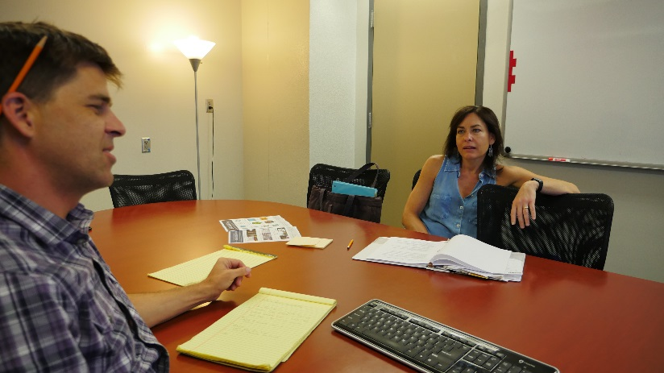
Instructional Design

Slide 4
Provide assistance on writing measurable Student Learning Objectives that align with activities and assessments
Design course layout, organization, and look (with instructor feedback)
Insert content and build assignments/assessments into Canvas
Distribute surveys for student feedback

Slide 5
ID services typically take a full semester of development
Full development vs. Partial development
Services are FREE! No cost to you or your department
Notes:
http://teach.ufl.edu/development/beyond-the-podium-discussion-series/

Slide 6
Request Course Assistance
www.citt.ufl.edu – Course Assistance Request Form
Other items on Website:
Tool Box
Online Teaching Resources-Active Learning, Student Engagement
Blog
Notes:
http://teach.ufl.edu/development/beyond-the-podium-discussion-series/

Slide 7
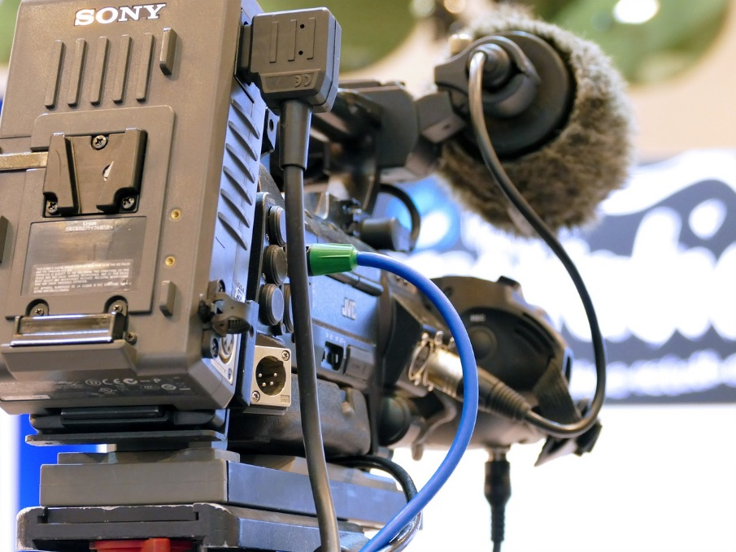
Video Services

Slide 8
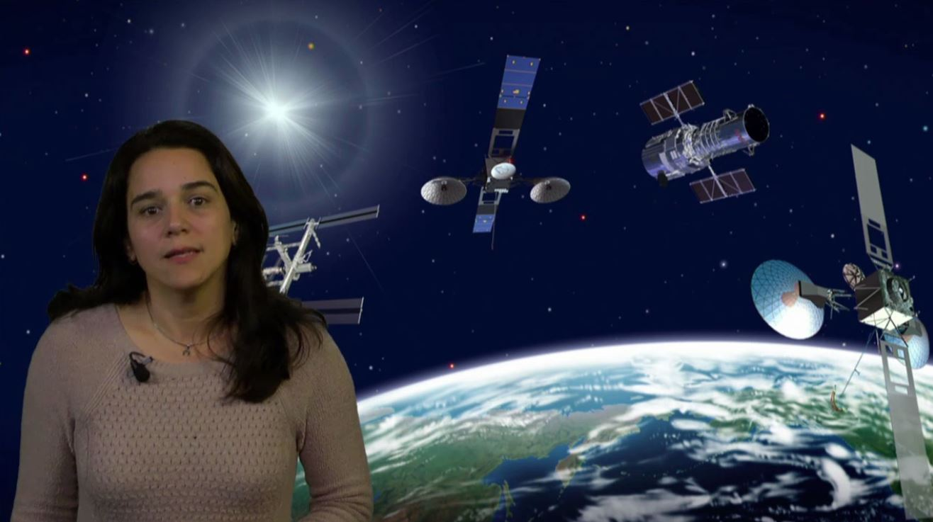
Knowledgeable studio staff
Green Screen recordings
Notes:
http://mediasite.video.ufl.edu/Mediasite/Play/c3f45cc302ba4936905467acc7b91d141d

Slide 9
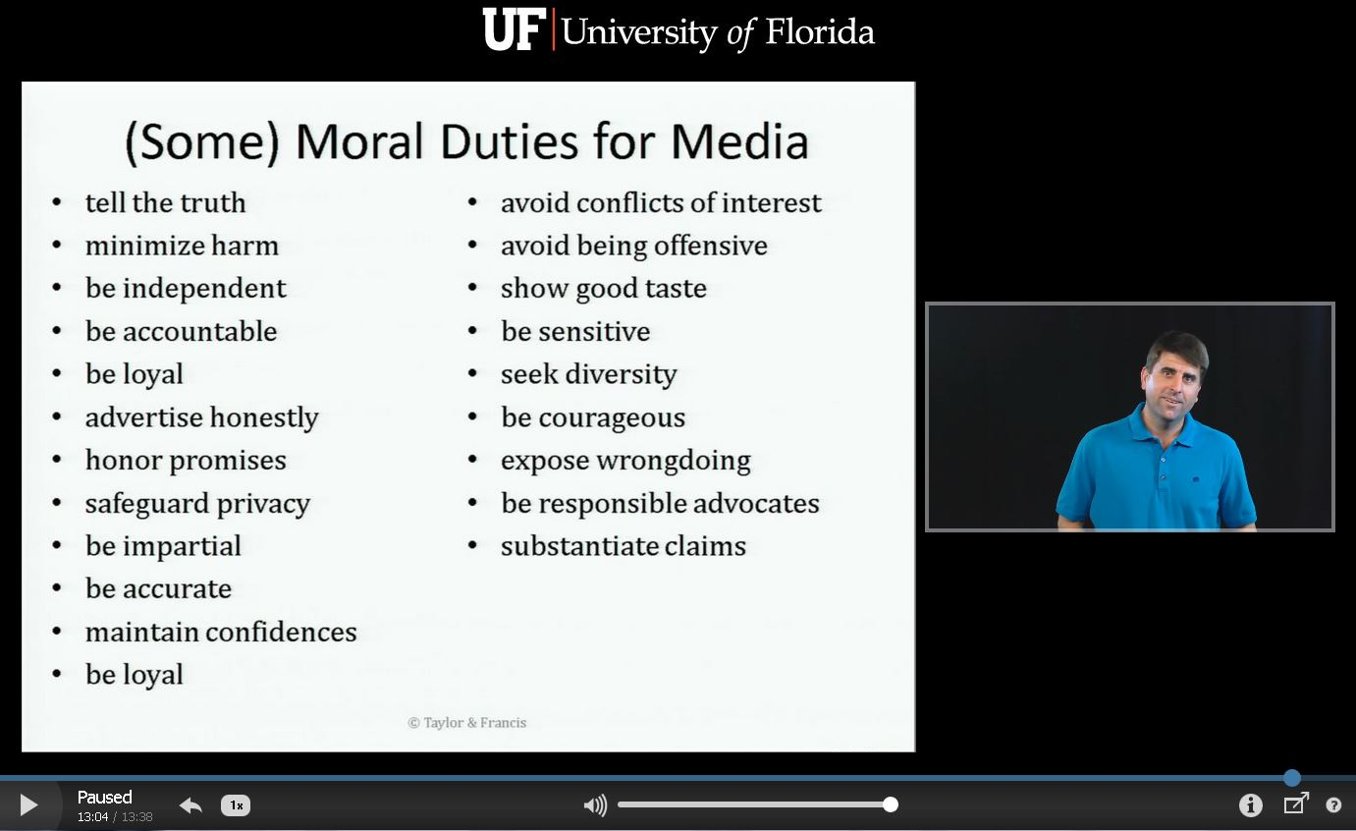
Knowledgeable studio staff
Green Screen recordings
Mediasite recordings
Notes:
http://mediasite.video.ufl.edu/Mediasite/Play/7009bc8f3c1047b49a06fbaae75c0e071d

Slide 10
Knowledgeable studio staff
Green Screen recordings
Mediasite recordings
Teleprompter available for using scripts
Assistance with Voice Over
Camtasia, Audacity, Captivate
Document camera capabilities

Slide 11

Training and Development

Slide 12
Provide Trainings for Faculty
Canvas Bootcamp
Using Peer Review
Power of Rubrics
Accessibility Training
Training.it.ufl.edu

Slide 13
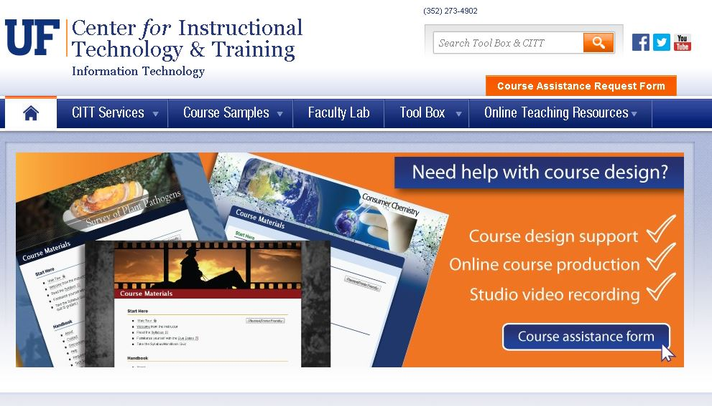
How to get help
Notes:
http://citt.ufl.edu/

Slide 14
Questions?

