Slide 1
Connecting to Distance Education Students
David Depatie, Instructional Designer

Slide 2
Adobe Connect - International Class
Offers a software that facilitates online discussion
With some major benefits for teaching issues:
  Has ability for live discussion (oral or chat function)
  Keeps a record of who came in/out of the room (with time stamps)
  Allows for “polling” questions (and tracks who answered what)
  Works from anywhere (best with a webcam and a stable connection)

Slide 3
Adobe Connect Stats
Introductory Session
  Offered 4-5 introductory sessions during drop/add and one on the first day after drop/add in case anyone added at the last second
  This was “syllabus lecture”
  Sets the tone and introduces the students to me very quickly
    Establishes that I am a ‘real person’ and can be contacted
Results from end of semester survey “Did the live lecture at the beginning of the semester help you understand the course?”
  Yes, better than reading the syllabus: 78-80%
  It would have been just as easy to read the syllabus: 10-18%
  I didn’t attend: 3-8%

Slide 4
Adobe Connect Poll Questions
“Live” sessions during semester
  Discuss current issues (not on exams)
  Limited to 30 minutes per session
  Offered different times of day (repeat most sessions twice)
  Mostly led by instructor, but sometimes guest speakers
  Allows for current topic discussion (had professor from Russia speak about Russia-US Embargo while it was starting
  Will likely have someone discuss Brexit implications on agriculture
  Require students attend any 2 different topics during the semester
    Some students attend more than 2
    Use Appointment scheduler in Canvas to track who will attend (require at least 5 sign up to hold, no more than 25 per session)
  Grade based on attendance, always ask 3 poll questions, and participation in chat

Slide 5
Adobe Connect Live in Online Class
Did you like the live sessions during the semester (not including the one that covered the syllabus)...
  Yes, future classes should be required to attend these more often: 34% (Spring 2016), 28% (Fall 2015); 21% (Spring 2015)
  Yes, 2 per semester is enough: 54% (Spring 2016); 56% (Fall 2015); 62% (Spring 2015)
  Yes, but they shouldn't be required 7-9%
  No, it was just busy work: 2-4%

Slide 6
Further thoughts - Instructor Evaluation up…
Overall course and instructor evaluations changed when added this component (not many other major changes)
  Prior to live session, instructor average was 4.15 over 4 semesters
  After live sessions, instructor average was 4.52 over 4 semesters
  Prior to live session, course average was 3.92 over 4 semesters
  After live sessions, course average was 4.46 over 4 semesters

Slide 7
Audio Setup Wizard EVERYTIME
Here are the directions for setup and use of Adobe Connect.
Please run test step 1 and watch video step 2
Hi All;
Please join us in an Adobe Connect Meeting
Meeting LINK -> FREseminars
Invited By: David DePatie (ddepatie@ufl.edu)
When: TBA
Time Zone: (GMT-05:00) Eastern Time (US and Canada)
Please run the following test on the computer you plan on using to join the meeting:
Before attending the Adobe Connect meetings please complete the following 2 steps
1) Test Your Computer Connection and Flash Version [LINK]
Then watch the following video to learn how to best use the Adobe Connect:
2) Run Audio Setup Wizard [VIDEO]; Every time you attend a meeting
If you have any problems please contact
David DePatie (ddepatie@ufl.edu)
or Ed Howard (edhoward@ufl.edu)
for Technical support.
Dave
: -)

Slide 8
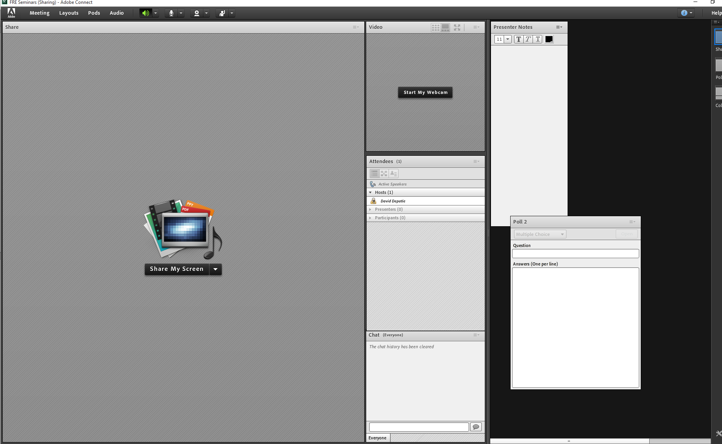
Presentation Area

Slide 9
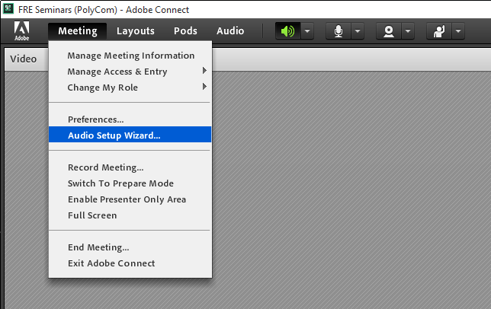
Audio Setup Wizard…

Slide 10
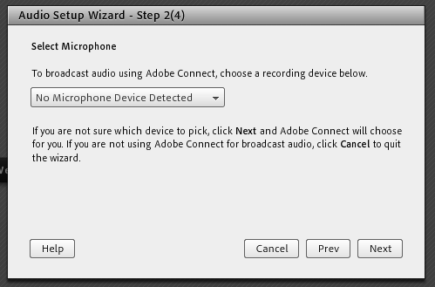
Connect Hardware First

Slide 11
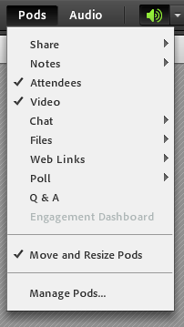
Pods…

Slide 12
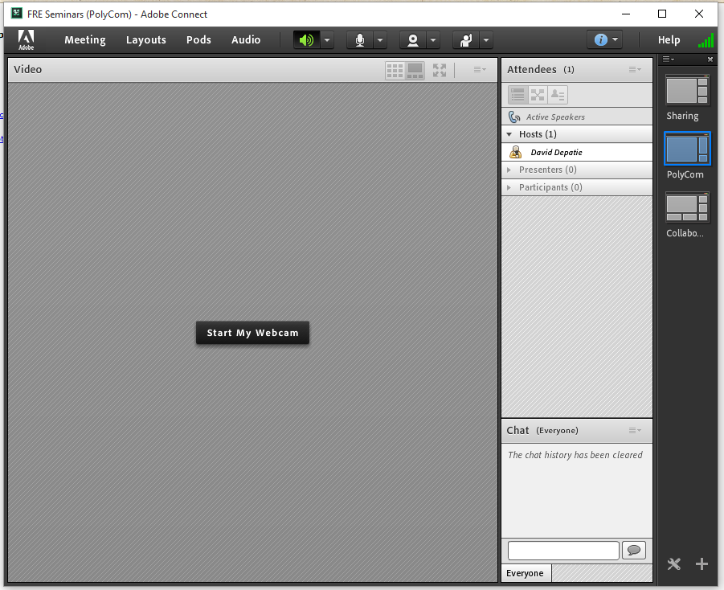
Layouts…

Slide 13
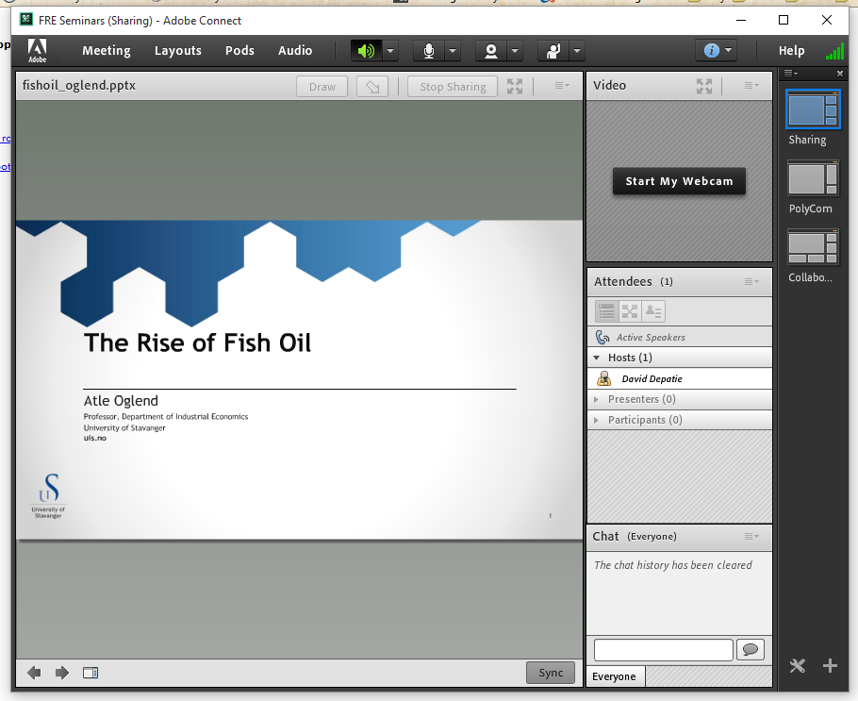
PPT / PDF (NOT PPTX)

Slide 14
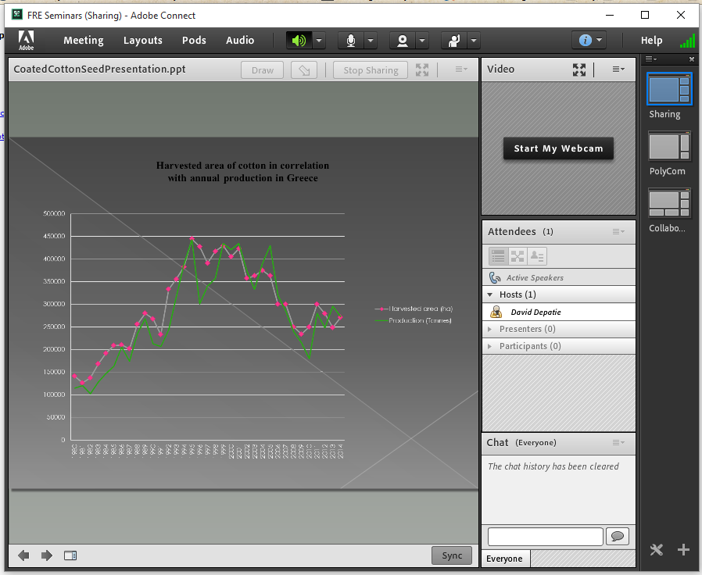
COLORS

Slide 15
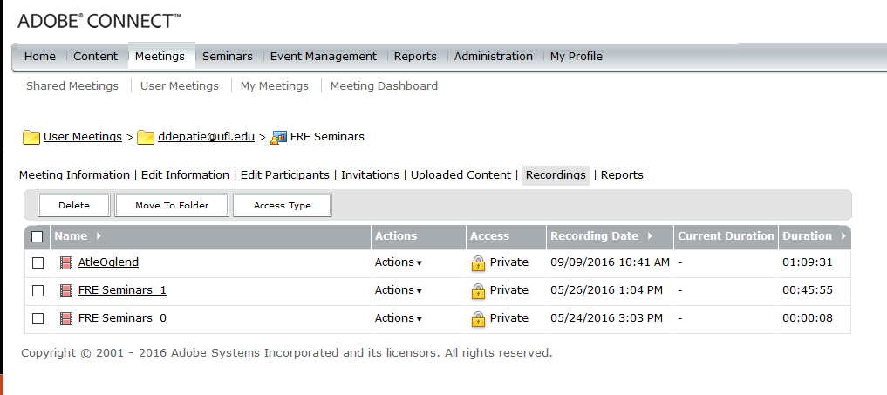
Recordings

Slide 16
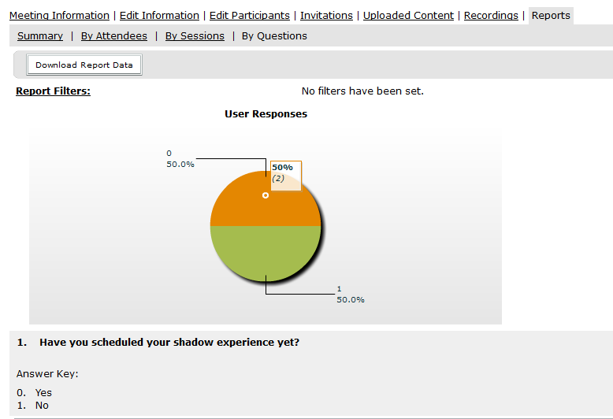
Reports…

Slide 17
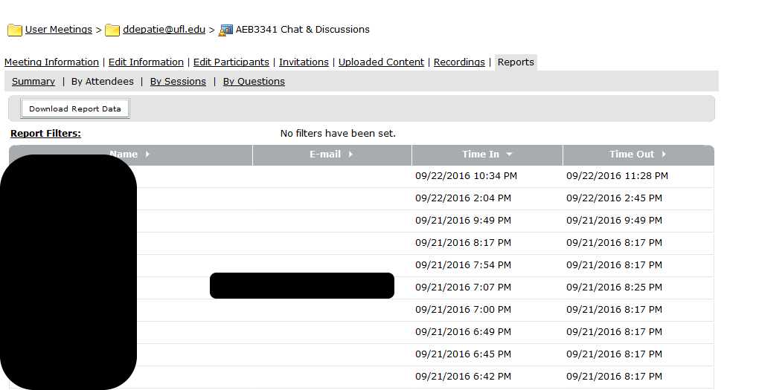
Automatic Attendance

