Slide 1
Design & Integration Services at the University of Florida
From Idea to Reality

Slide 2

Who are We ?
Design & Integration Services is an Auxiliary operation within UFIT Academic Technology

Slide 3
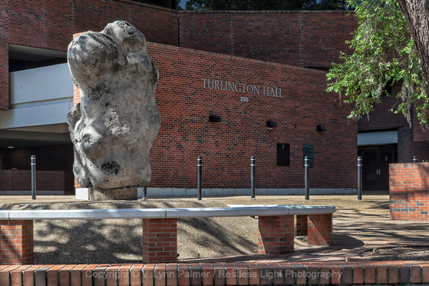
Who are We ?
Design & Integration Services is an Auxiliary operation within UFIT Academic Technology
We are located in room 1126 of Turlington Hall

Slide 4
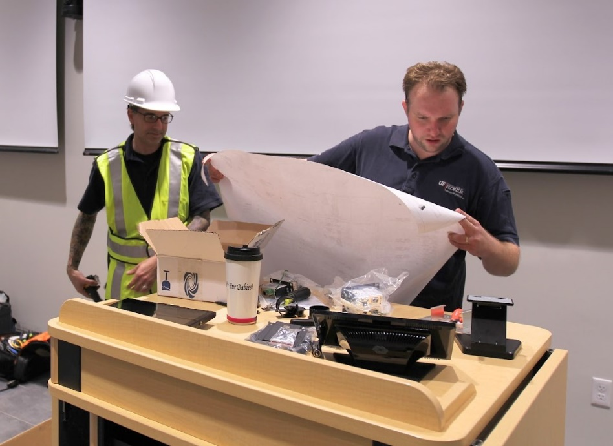
Who are We ?
Design & Integration Services is an Auxiliary operation within UFIT Academic Technology
We are located in room 1126 of Turlington Hall
Our normal hours of operation are from 8am-5pm M-F

Slide 5
History
Our unit was established in 2001 to provide an in-house Design & Integration capability for University customers outside of the classroom operations of Academic Technology

Slide 6
History
Our unit was established in 2001 to provide an in-house Design & Integration capability for University customers outside of the classroom operations of Academic Technology
Our goal was to provide the same philosophy of consistency in design and operation along with high installation standards at a reduced price to the University that was being applied to classrooms

Slide 7
History
Integration of multimedia and technology in construction has gone from being a luxury add-on to being a required component of every renovation, remodeling, and new construction project

Slide 8
History
Integration of multimedia and technology in construction has gone from being a luxury add-on to being a required component of every renovation, remodeling, and new construction project
Project numbers, size, and complexity have steadily increased every year of operation

Slide 9
History
Integration of multimedia and technology in construction has gone from being a luxury add-on to being a required component of every renovation, remodeling, and new construction project
Project numbers, size, and complexity have steadily increased every year of operation
Installation services has steadily grown from providing design and integration for a few specialty rooms to entire buildings of multimedia and control systems

Slide 10

The Process
First: We meet with the customer to discuss what they want to be able to do.

Slide 11
The Process
First: We meet with the customer to discuss what they want to be able to do.
“ It’s important not to go into design mode until we fully understand their needs”

Slide 12
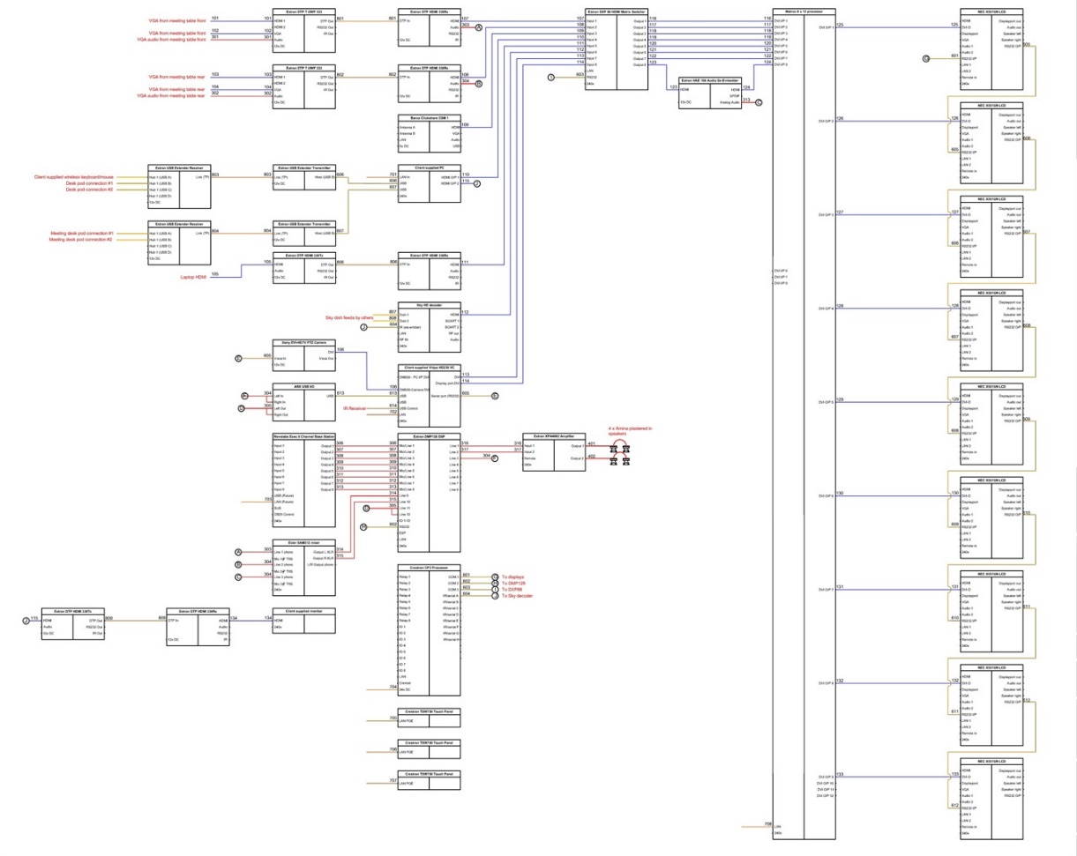
The Process
Next: We design a complete working system that allows the customer to do what the customer wants to do.

Slide 13
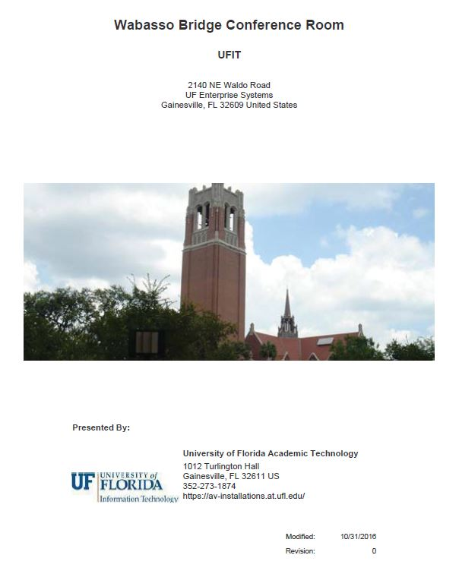
The Process
Next: We deliver a detailed quote to the customer which includes the scope of work to be done, complete equipment and materials cost, and total cost of labor to install.

Slide 14
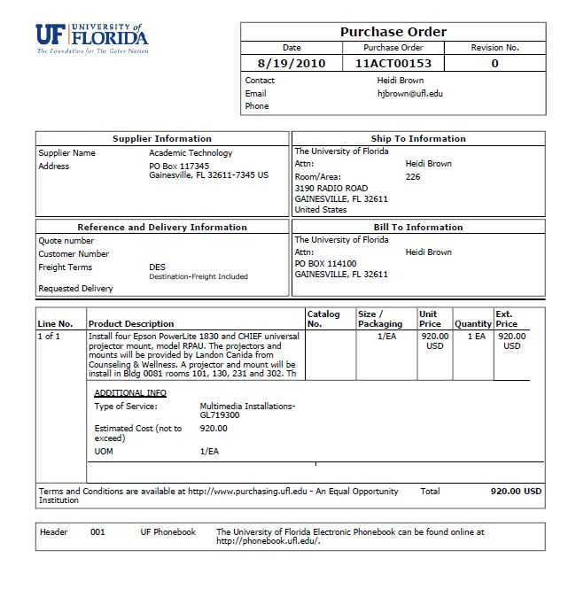
The Process
Next: The customer reviews, approves, and then transfers the funds to do the job.

Slide 15
The Process
Next: The customer reviews, approves, and then transfers the funds to do the job.
Because we are an Auxiliary operation, we have no funds to purchase then invoice the customer after the job is done. It is important to note that there is no mark-up in the cost of equipment or materials to the customer. “They pay what we pay”

Slide 16

The Process
Next: Once funds are transferred, all the purchases are made in equipment and materials for their job.

Slide 17

The Process
Next: Once funds are transferred, all the purchases are made in equipment and materials for their job.
Once all the equipment and materials have arrived, we contact the customer and schedule the installation.

Slide 18
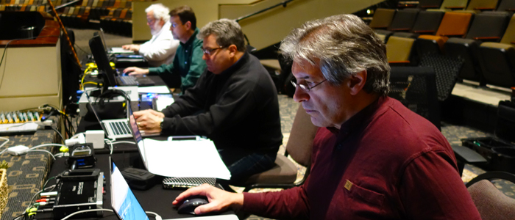
The Process
Once installation is complete, we test and balance all systems and equipment and make any required alterations or changes needed before customer hand-off.

Slide 19
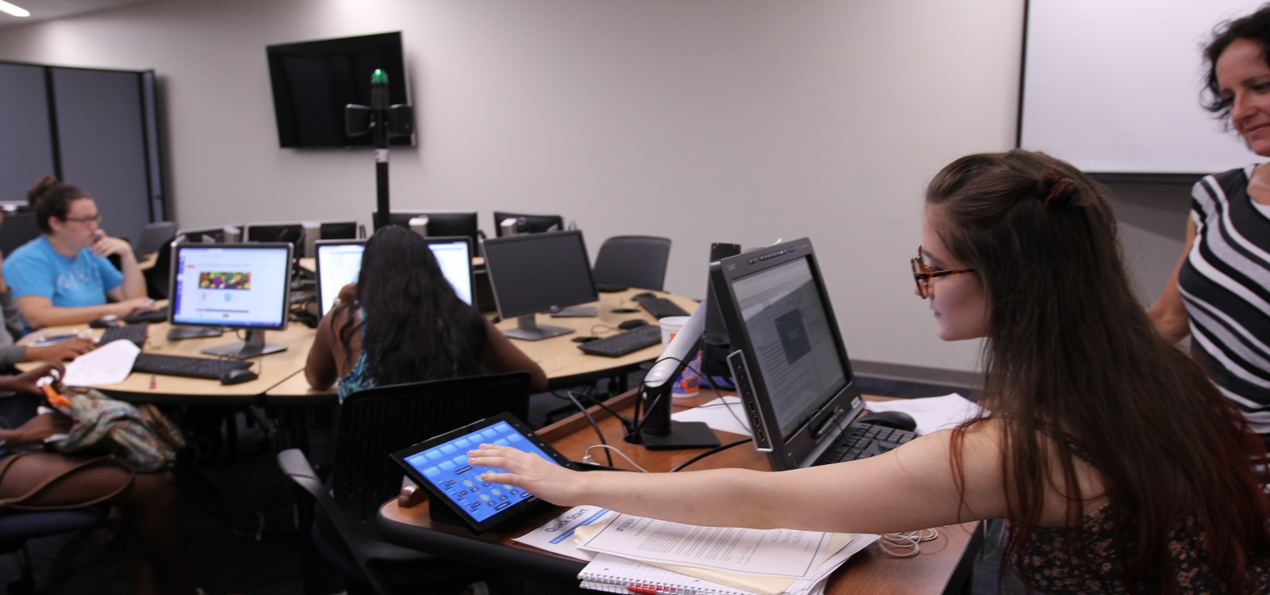
The Process
Finally, we meet with the customer, walk them through the systems, provide any training required, and get sign-off that the project is completed.

Slide 20
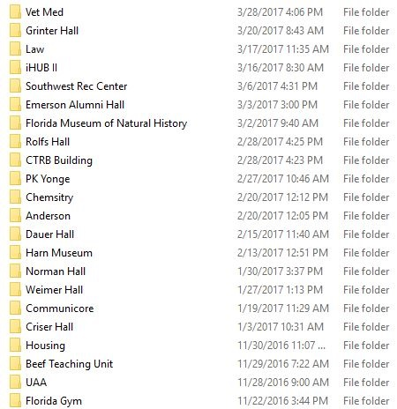
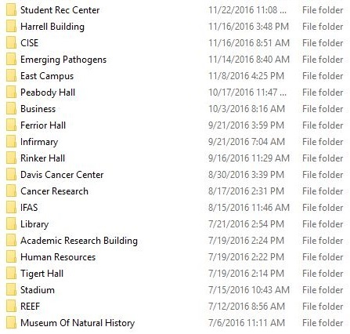
FY 2016-17 Projects

Slide 21
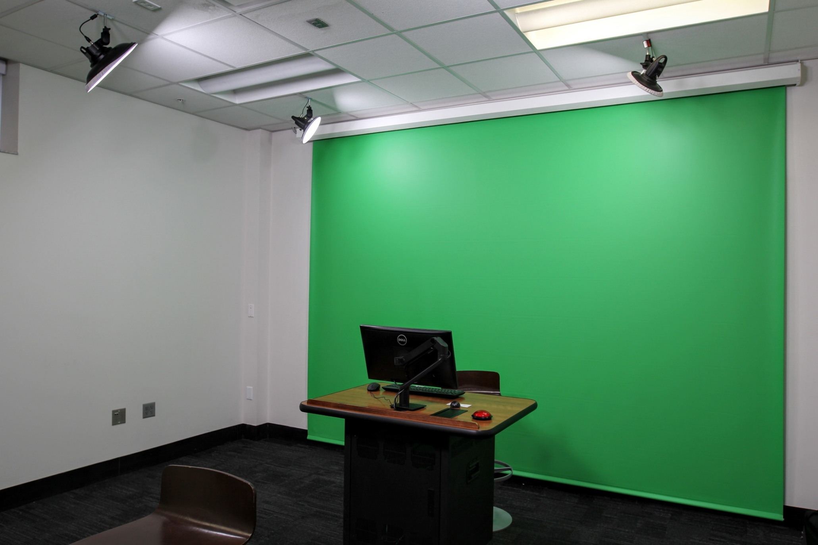

Slide 22
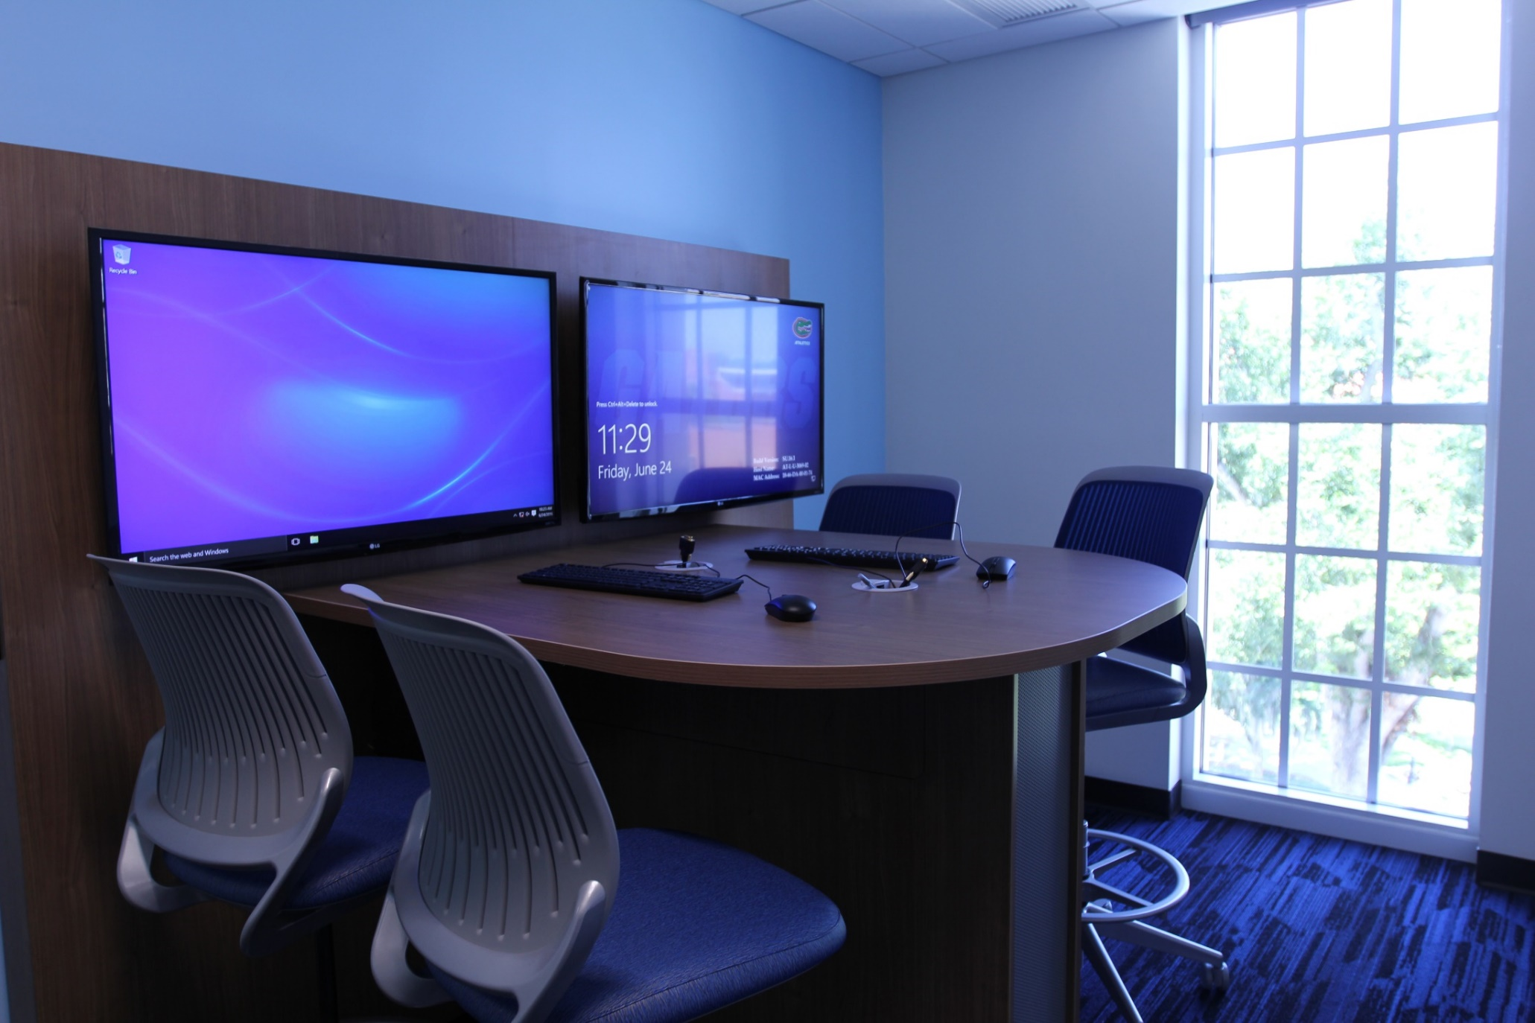

Slide 23
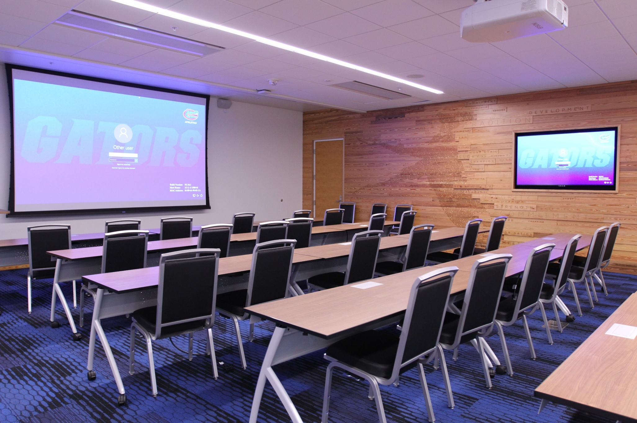

Slide 24
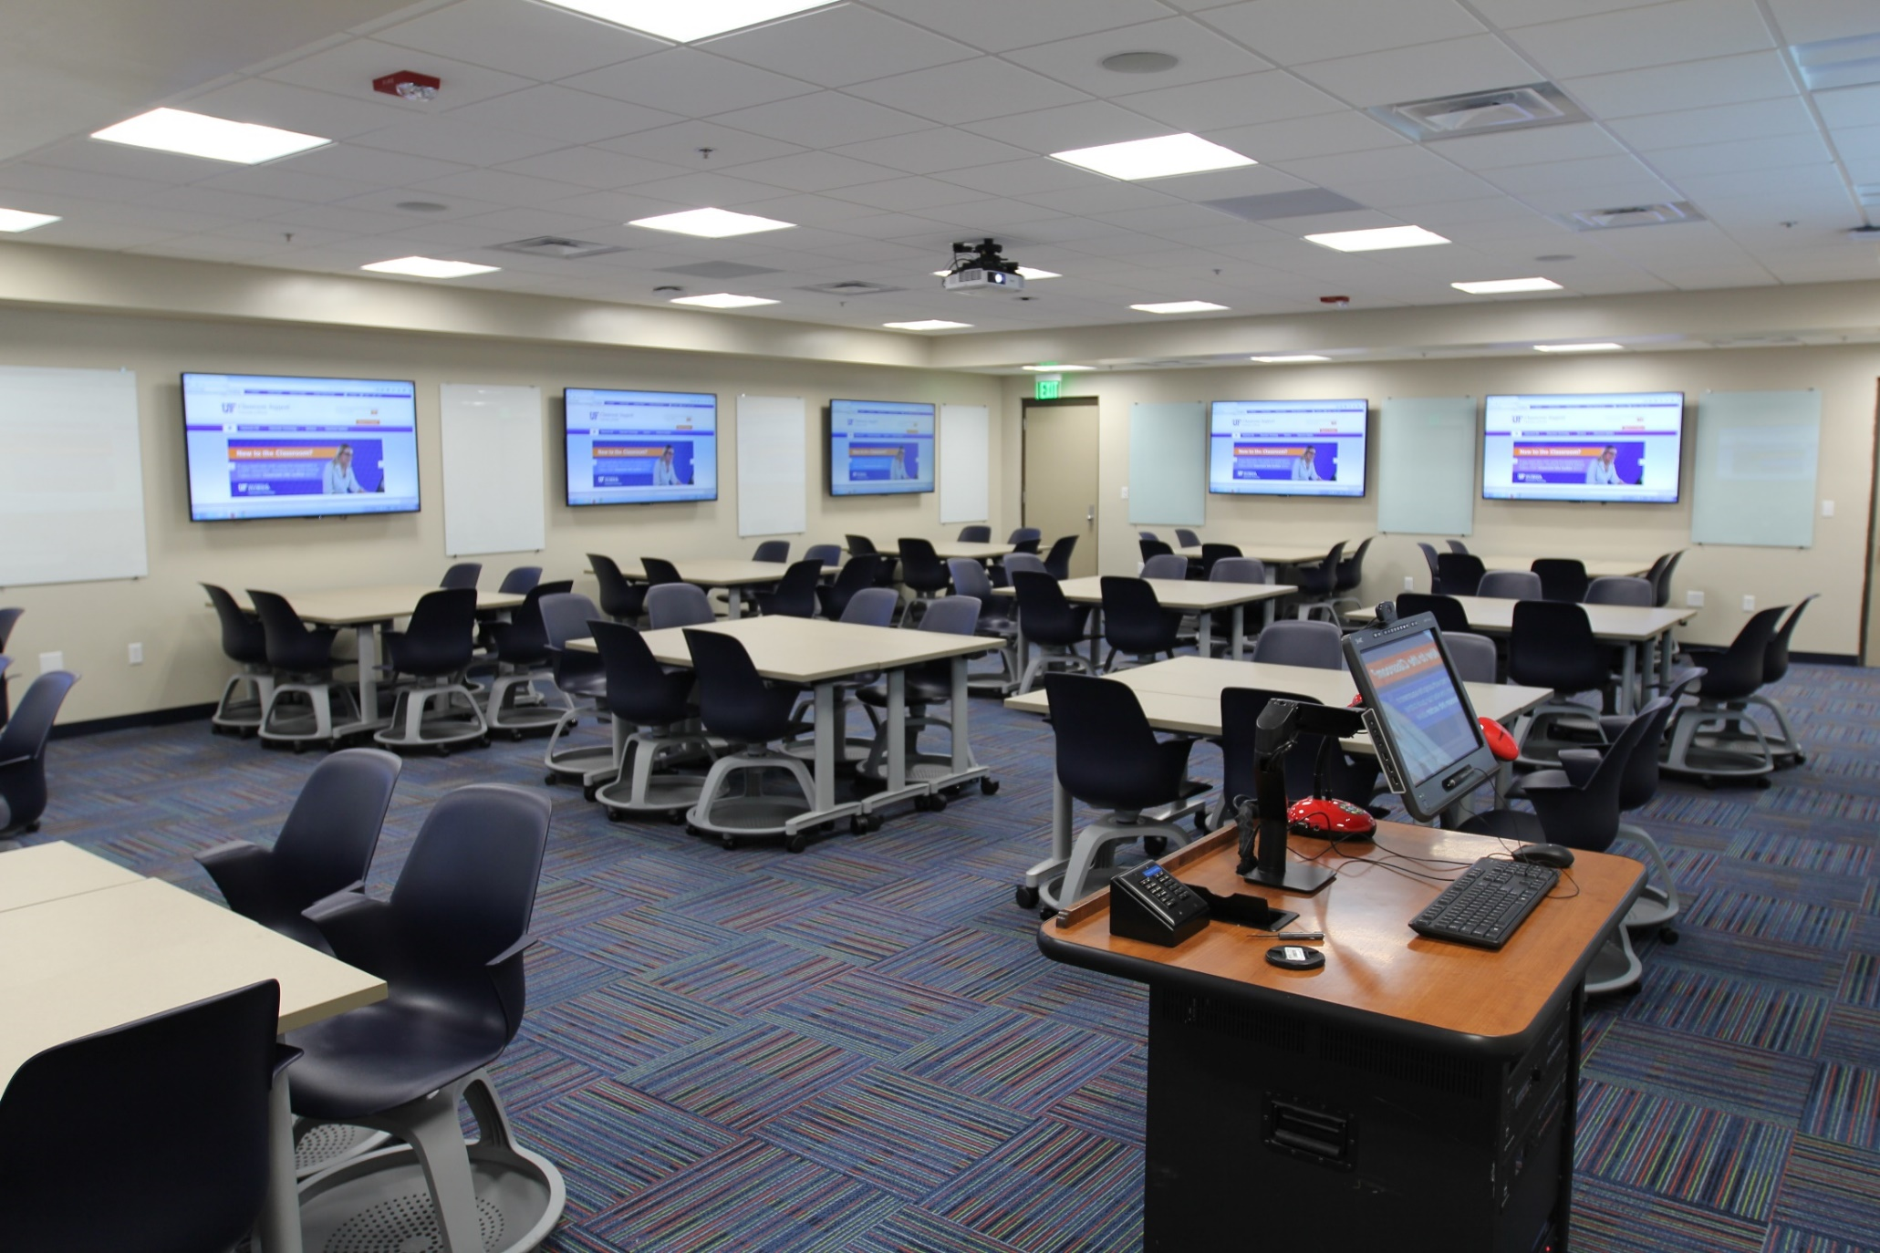

Slide 25
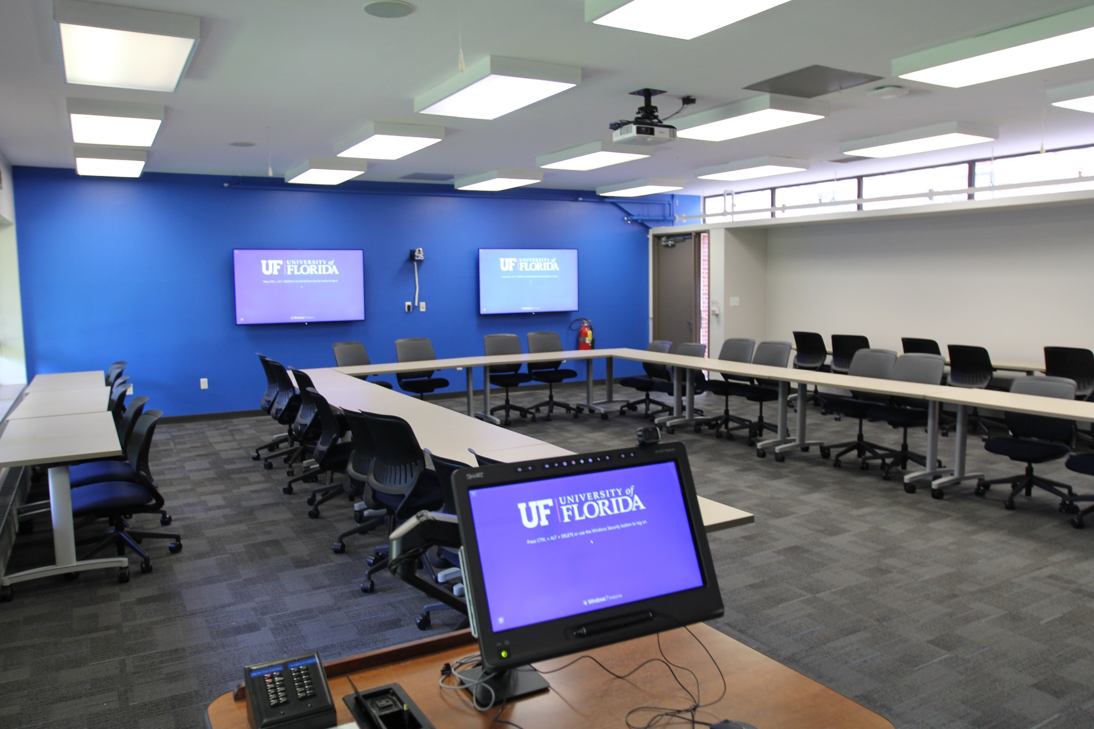

Slide 26
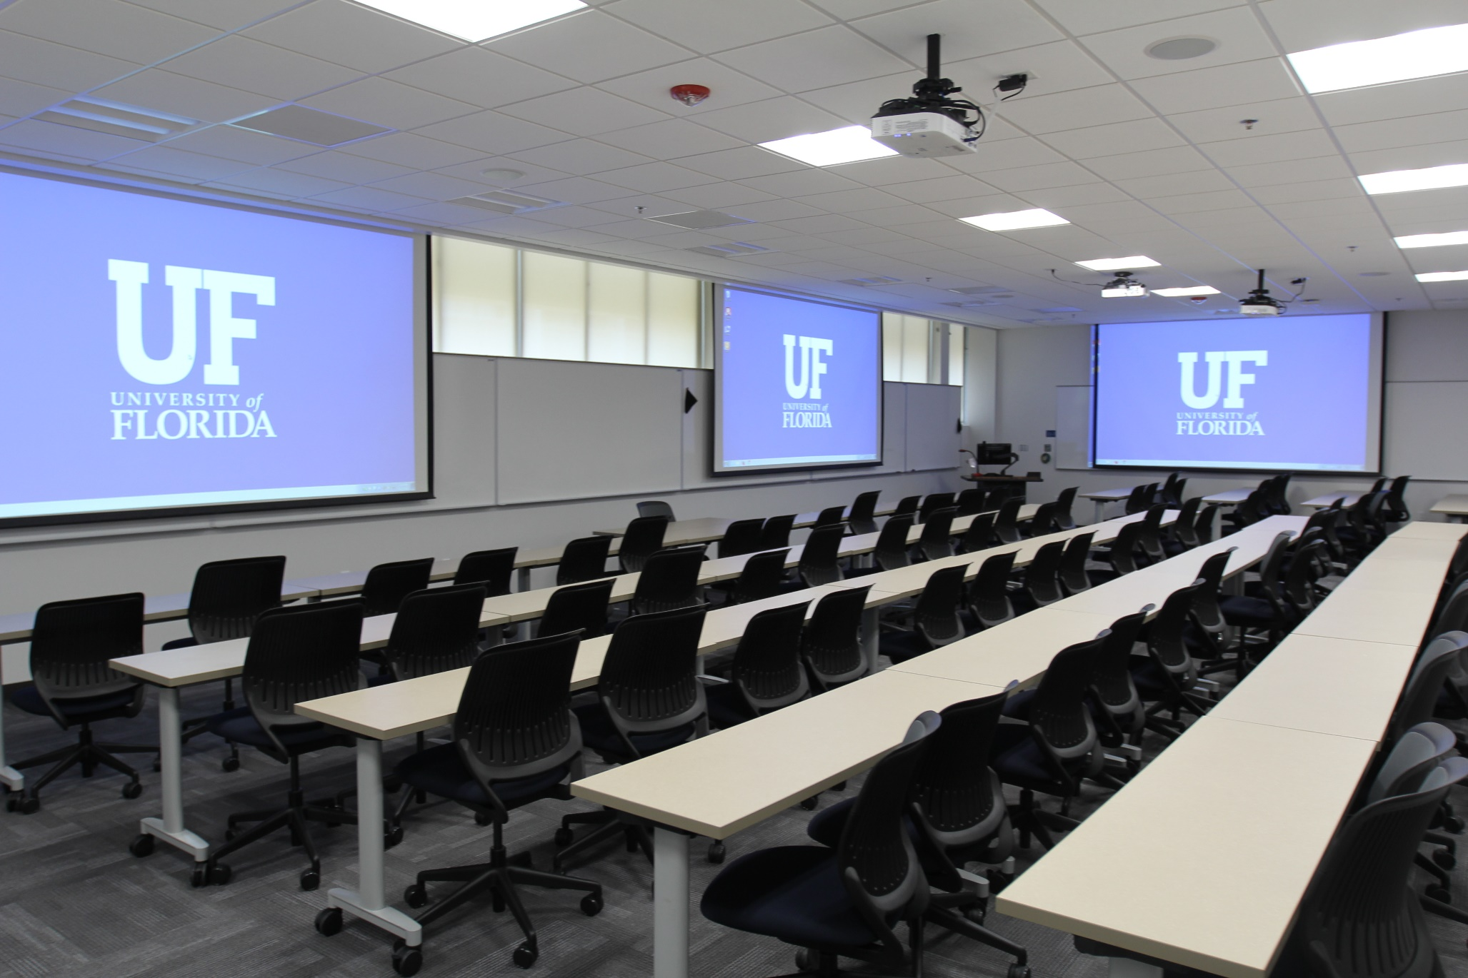

Slide 27
