Slide 1
GatorLink Account Management
Kerry Bader, Identity & Access Management
Nick O’Connor, UF Computing Help Desk

Slide 2
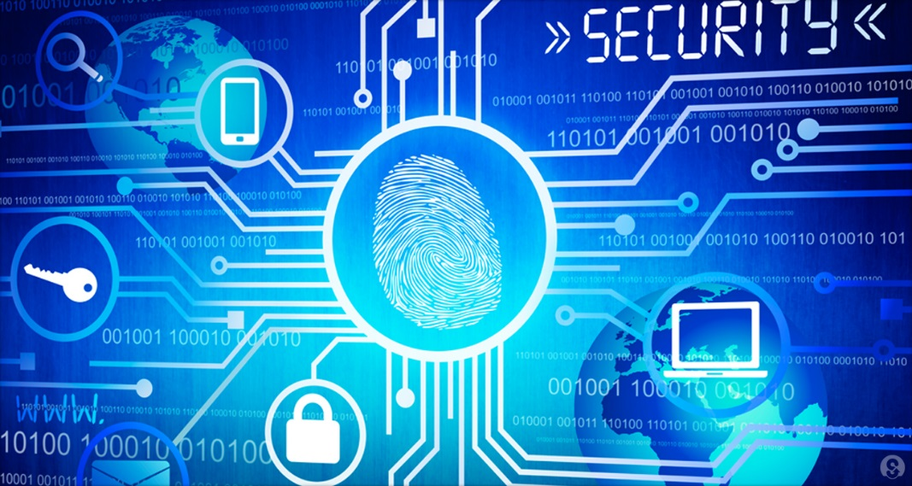
Why Change?
  GatorLink Account Management
Forgot Password
Vulnerability of Security Questions
Compromised Accounts
Better information for the UF Registry
Self Service Functionality
Less Username Replacements

Slide 3
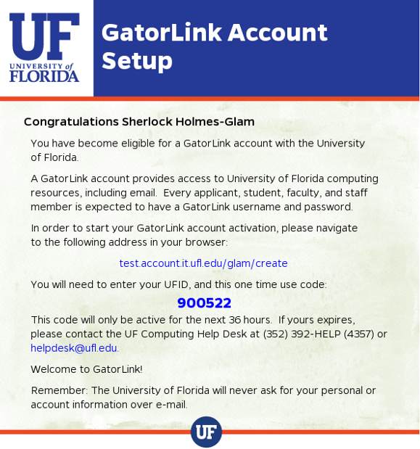
GLAM
Requirements: Account Creation & Password Reset
Eligibility Requirements
  Name
  Date of Birth
  UFID number
  Qualifying Affiliation
  New: Phone number
  New: Personal email
Once eligible, users should receive an invitation with instructions within 5 min.
Technical Requirements
  Access to the phone and email listed
  Ability to use Google reCAPTCHA

Slide 4
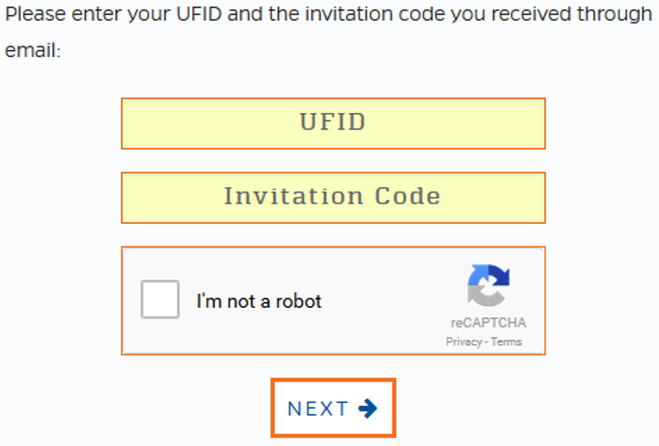
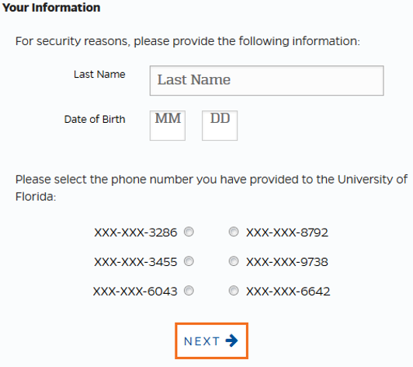
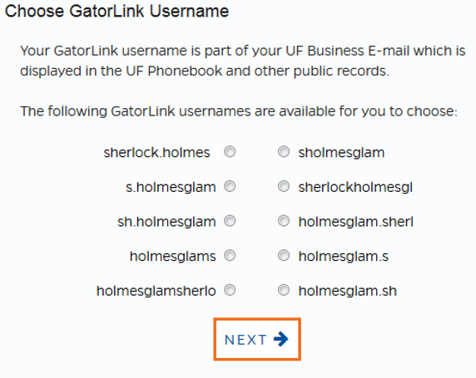
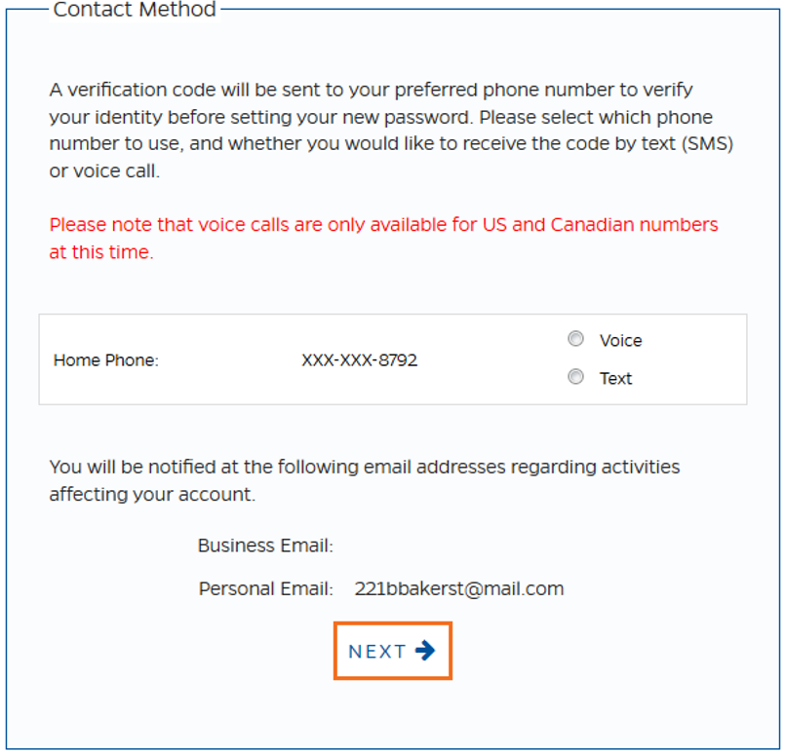
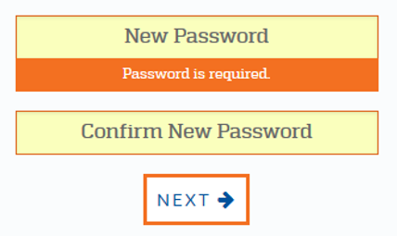
GLAM
Account Creation
Receive Invitation
  Go to Navigation
  Enter UFID/Code
Answer verification questions
  Last Name/DOB/Last 4 digits of phone
Select a username
  10 choices
Get a code by text/call to confirm phone
Set a password

Slide 5
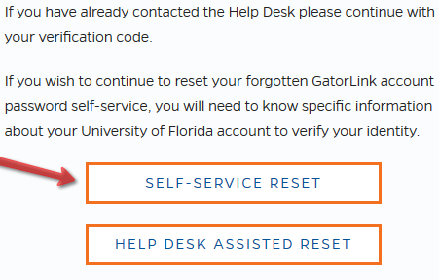
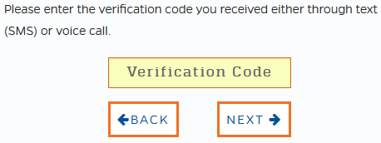
GLAM
Reset Password
Login.ufl.edu > Forgot Password
Self-Service Reset
Answer verification questions
Get a code by text/call
Set a new password

Slide 6
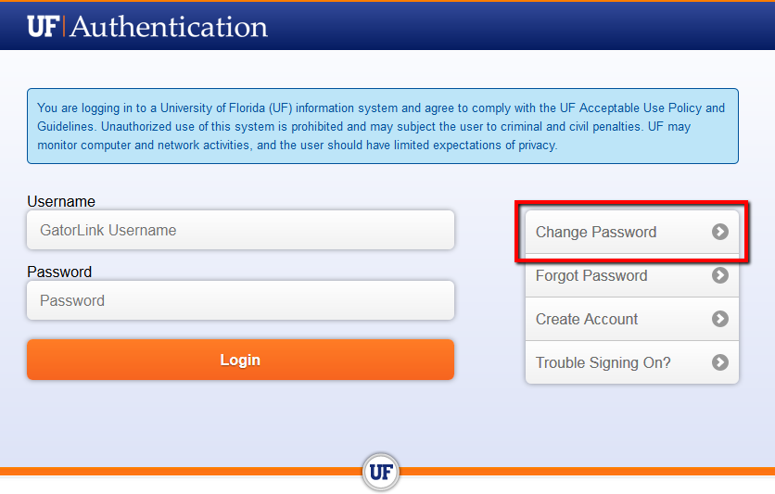
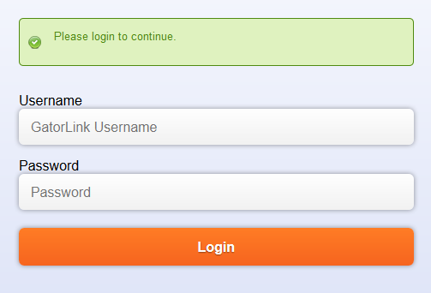
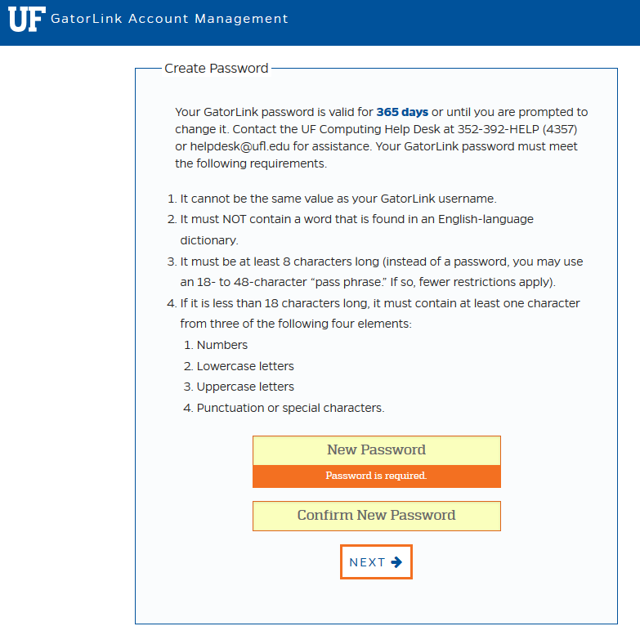
GLAM
  Change Password
If you know your current password, simply visit login.ufl.edu
Click ‘Change Password’
Log in with your GLID and current password
Enter new password
Notification email will be sent

