Slide 1
UFEM Update
September 23, 2016

Slide 2
Agenda
CPM and OfficeScan Update
Patch Management Update

Slide 3
IBM & Trend Micro
IBM & Trend’s business relationship is changing…
  Core Protection Module (CPM)
    BigFix’s Antivirus Solution: basic AV, no new functionality from Trend
    EOM: December 2016
    EOS: December 2017
1:1 License Conversion
  CPM : OfficeScan Endpoint Protection
Migration
  Targeted end of year completion; likely February

Slide 4
BigFix Protection vs. Trend Micro OfficeScan
Function | Feature | Protection | OfficeScan
Smart Protection Server | Support upgraded Smart Scan Server 3.0 | ✓ | ✓
Advanced Service | CCSF – Browser | ✗ | ✓
DLP / Device Control | DLP (content filtering) and Device Control User Justification support Smartphone and Tablet support Updated data identifier and template libraries Multi-rule policies Enhanced DLP log details Extended non-storage device support Extended DLP channel support | ✓ ✗ ✗ ✗ ✗ ✗ ✗ ✗ | ✓ ✓ ✓ ✓ ✓ ✓ ✓ ✓
Command & Control | Global User-defined Approved and Blocked IP lists Malware network fingerprinting to detect C&C callbacks Granular action configuration when suspicious connections are detected C&C server and agent logs record the process responsible for C&C callbacks Global Intelligence C&C server lists NCIE integration - C&C IP list | ✓ ✗ ✓ ✗ ✓ ✓ | ✓ ✓ ✓ ✓ ✓ ✓
Enhancement | Trusted Program Persistent scan cache, global approved list Support deferred scanning | ✗ ✗ ✗ | ✓ ✓ ✓
Agent Interface Redesign | Redesigned new web-style agent console | ✗ | ✓
CryptoLocker Solution | Protect documents against unauthorized encryption or modification Block processes commonly associated with ransomware | ✗ ✗ | ✓ ✓
Behavior Monitoring Enhancement | Behavior Monitoring Scan Enhancement, including CryptoLocker detection by Behavior Monitoring Enhanced Behavior Monitoring in Ransomware detection and protection | ✓ ✗ | ✓ ✓
Other Features | Virtual Desktop Infrastructure support Firewall support | ✓ ✓ | ✓ ✓
Platform Support | Support for Windows 10 Support for Mac OS X | ✓ ✓ | ✓ ✓

Slide 5
Next Steps…
Technical Review and Architecture/Migration assistance from IBM/Trend
UFEM Governance Committee
  Review OfficeScan capabilities (functional/technical) and assist in defining move forward priorities
Test environment implementation and UFIT guinea pigging; followed by production environment rollout and UFIT first-in
Refine customer onboarding process, including training/knowledge transfer
Managed migration of current dept/college using CPM to OfficeScan
General Availability and rollout to campus
Questions?

Slide 6
Patch Management
Goals:
Provide units with a low-maintenance, BigFix-based patching system
Reduce the number of actions and baselines in the system through shared use
Flexibility – Give units as much control as possible

Slide 7
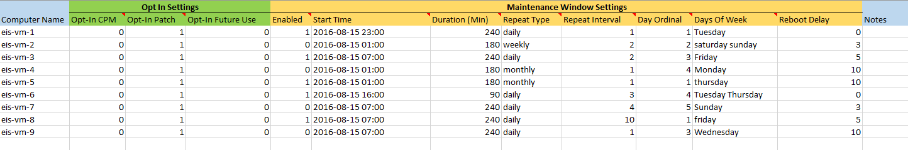
Patch Mangement
Master Settings File
Used by units to control all aspects of patching
Fill out Excel file template
Save as text file
Import into BigFix Console

Slide 8
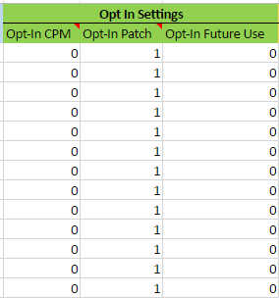
Patch Mangement
Master Settings File – Opt In Settings
Designate if a computer is opted in or out
  1 denotes the device is in
  0 denotes the device is out

Slide 9
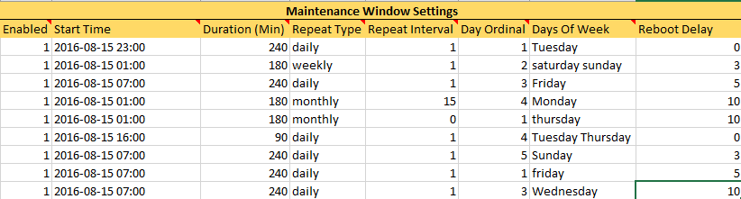
Patch Mangement
Master Settings File – Maintenance Window Settings
Designate if a computer has a maintenance window or not
If yes, specify details of maintenance window
Notes:
Repeat Interval: How often the Maintenance Window repeats. A weekly Repeat Type with Repeat Interval of 2 would run every other week

