Slide 1
IT Service Management
Peer 2 Peer
Spring 2015

Slide 2
Agenda
What is ITSM and why do we care?
Latest ITSM Timeline
The Experience
What’s Next?
Questions?

Slide 3
What & Why?
ITSM is the collective behaviors, competencies, processes and technologies that drive an IT organization’s ability to deliver IT services effectively & efficiently.
Valuea
Ability to showcase IT value to you based on performance!
Better visibility into status of customer issues and service requests
A consistent customer experience across IT functional teams
Complete view of trends and performance of service requests, incidents, changes, and any other established processes

Slide 4
Agenda
What is ITSM and why do we care?
Latest ITSM Timeline
The Experience
What’s Next?
Questions?

Slide 5
ITSM Spring Timeline (Originally)
2015
January
February
March
April
May
UFIT Continual Service Improvement
Change Mgmt. Planning & Design
Change Mgmt. Roll-out Waves
Phase 2 - UFIT Change Mgmt. Target State
UFIT- Deploy Change Management
2015: Problem Mgmt.
& Configuration Mgmt.
IT Partners Wave 1 – Law, MSE, EPI & UFIC – 17
Onboarding Activities
IT Partners Wave 1 –
Go Live
IT Partners Wave 2 – PHHP and IFAS – 30
Onboarding Activities
IT Partners Wave 2 – Go Live
IT Partners Wave 3 –
CLAS – 10*
Onboarding Activities
IT Partners Wave 3 – Go Live
Shared Services Requirements and Design*
Shared Services Pilot*
Shared Services Wave 2*

Slide 6


What is FISMA?
  Federal Information Security Management Act, became law in 2002 as part of the E-Government Act of 2002
  Requires federal agencies to strengthen information security programs and report progress back to Congress on an annual basis, in a consistent manner (using letter grades, A, B, C, D, F)

Slide 7
ITSM Post FISMA Timeline
2015
January
February
March
April
May
June
July
UFIT Continual Service Improvement
Phase 2 - UFIT Change Mgmt.Target State
UFIT- Deploy Change Management
Phase 2 - UFIT Config. Mgmt.Target State
UFIT- Deploy Config. Management
2015: Problem Mgmt.
IT Partners Waves – Law, MSE, UFIC [1], HHP & IFAS [2], CLAS [3]
Onboarding Activities
IT Partners Waves 1 through 3
Go Live
Shared Services Requirements and Design*
Shared Services Pilot*

Slide 8
Agenda
What is ITSM and why do we care?
Latest ITSM Timeline
The Experience
What’s Next?
Questions?

Slide 9
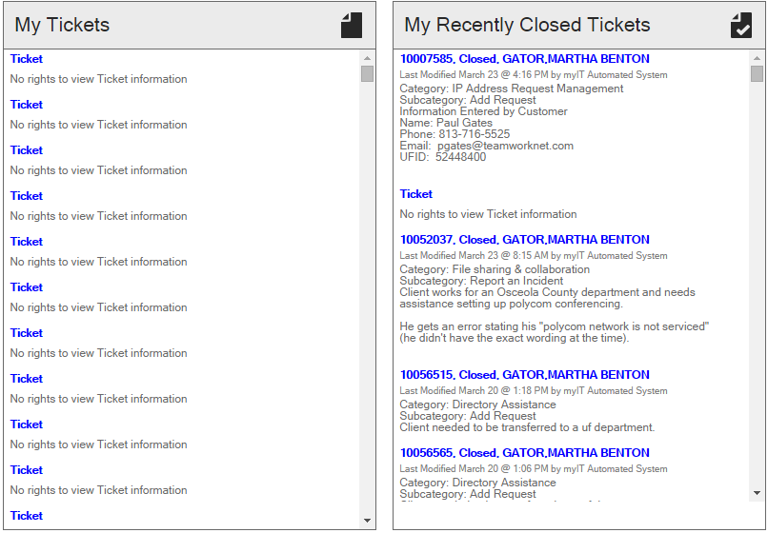
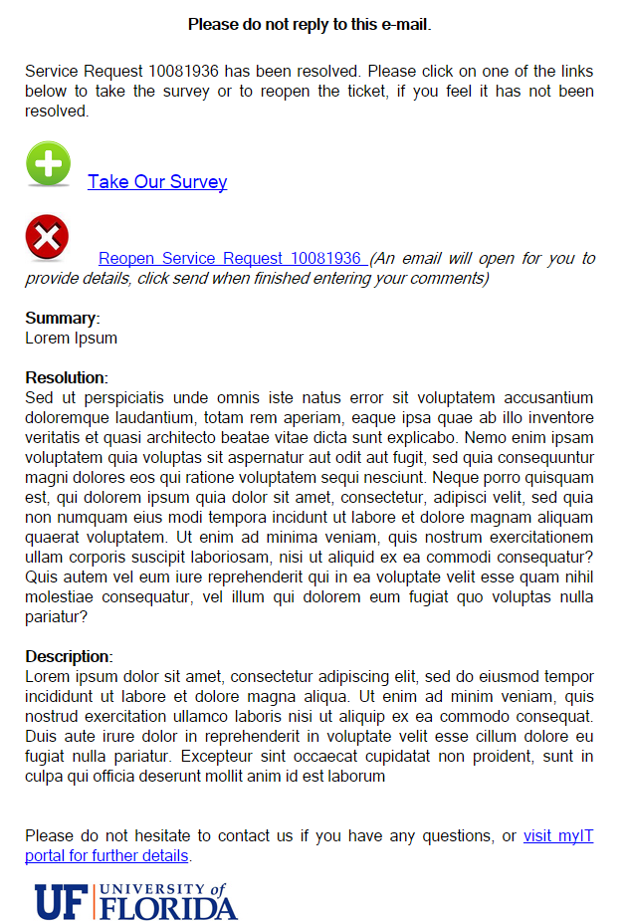
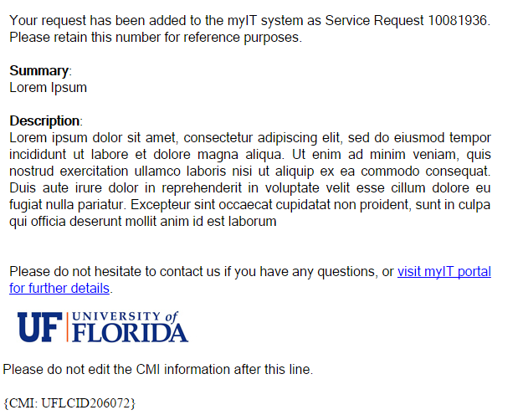
What’s the Customer Experience?
Do these look familiar?

Slide 10
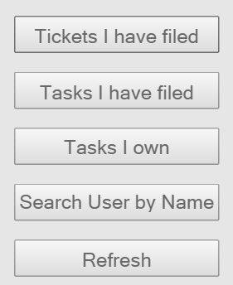
What’s the Technician Experience?
Team Structure/Queues
Service Requests or Incidents with Customer Information (including Dept ID, GL, UFID)
Email Monitors
Journal Notes
Customer Communications
Dashboards/Searches/Reports

Slide 11
Agenda
What is ITSM and why do we care?
Latest ITSM Timeline
The Experience
What’s Next?
Questions?

Slide 12

What’s Next?
If you’re interested in joining:
  myIT is unfortunately not an RCMed service
  However, the only cost to you is the annual license cost

Slide 13
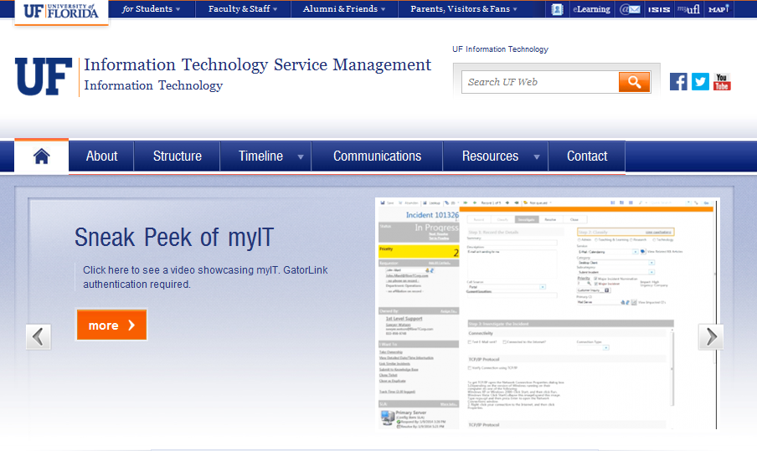
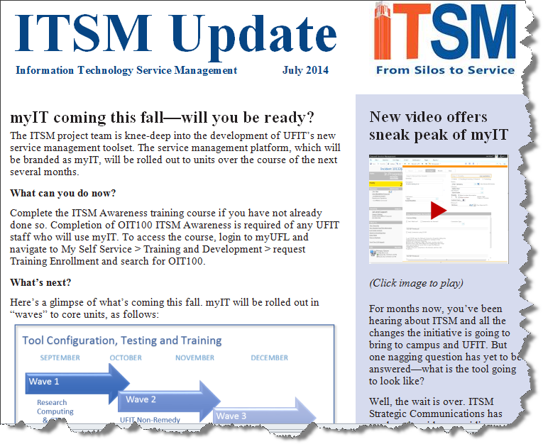
What’s Next?
http://www.it.ufl.edu/itsm/
For you:
  ITSM Website
  ITSM Newsletters
For your Customers:
  As UFIT folds its different units into a single toolset, you should expect to contact us through a single customer portal

Slide 14

What’s Next?
Service Management is a Journey
If you or your customers experience delays or confusion in any support experience with UFIT, please do not hesitate to contact us!

Slide 15

Questions?
Ufit-itsm@ufl.edu
http://www.it.ufl.edu/itsm
hank you!

