Slide 1

Agenda
Background
What is ONE.UF?
Current State
Future State
“ONE.UF will eliminate obstacles and enable access to services through a consistent, integrated and intuitive user experience built around customer needs.”
4/9/2015

Slide 2
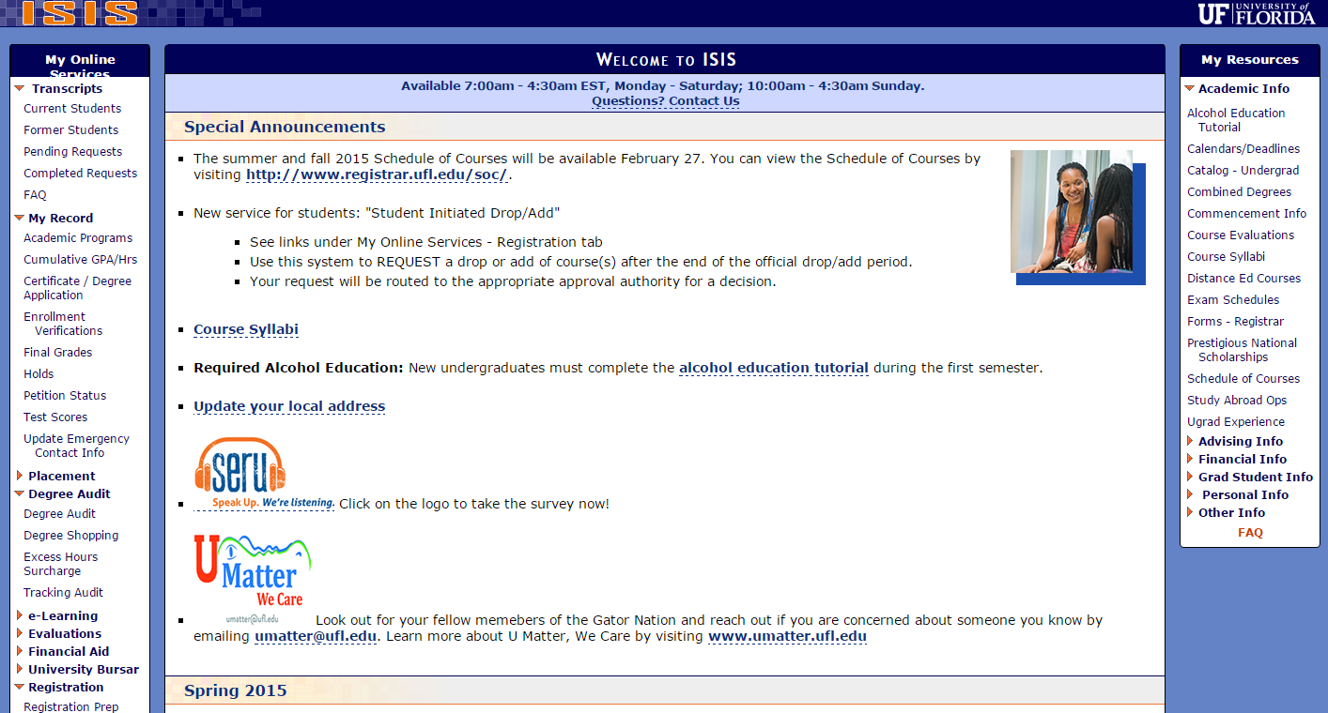
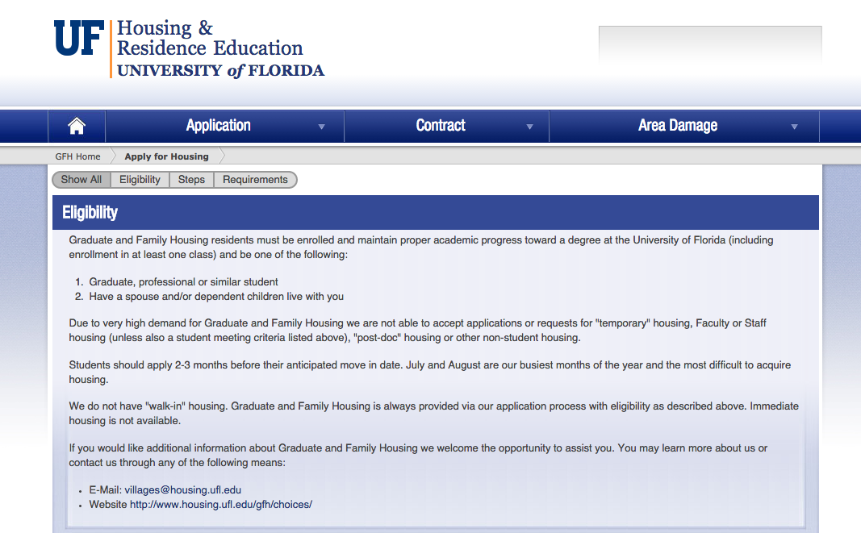
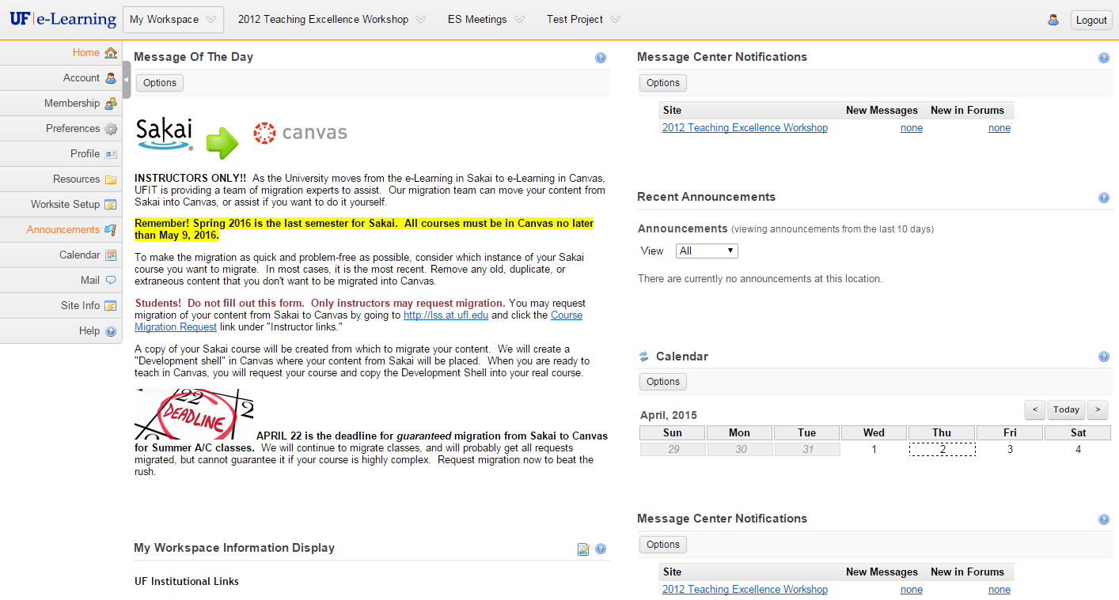
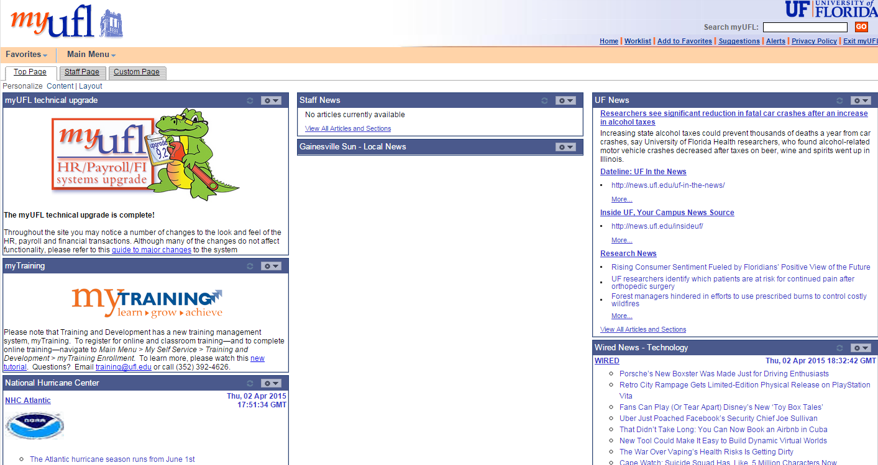
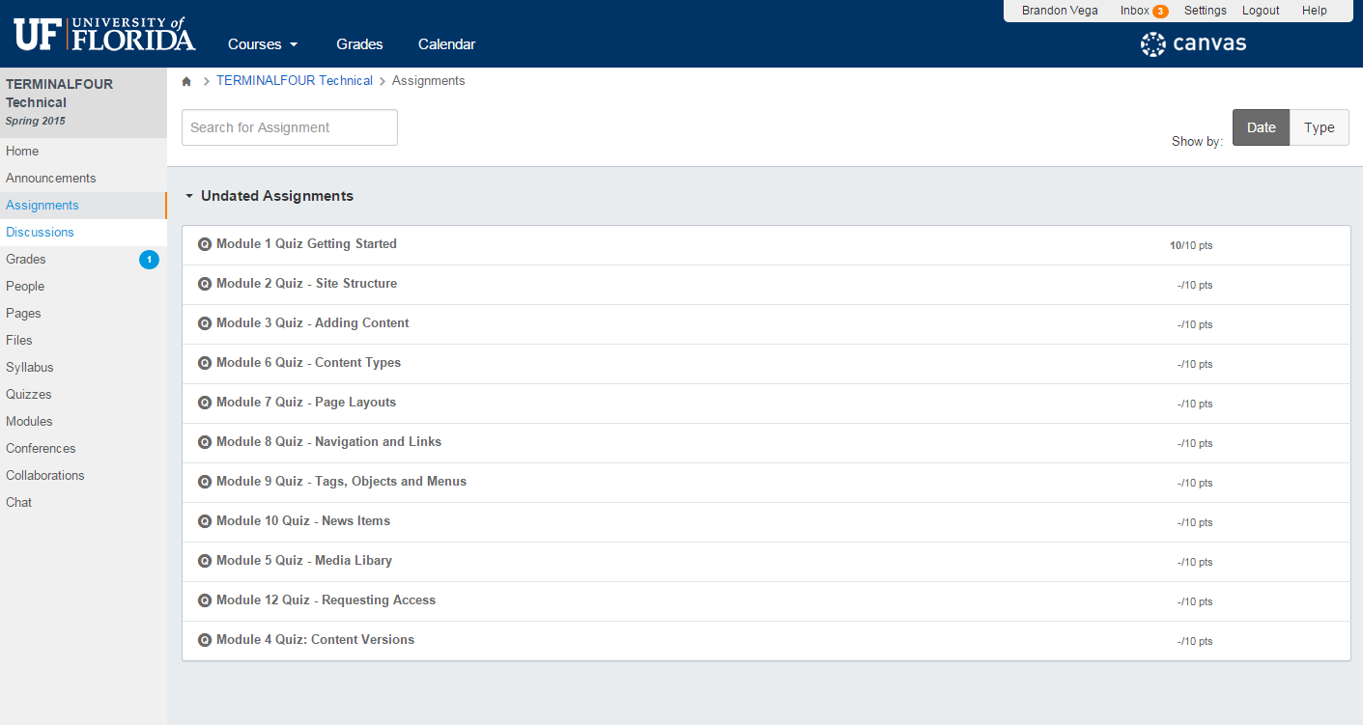
Background
Confusing?

Slide 3

Bad UX (user experience)

Slide 4
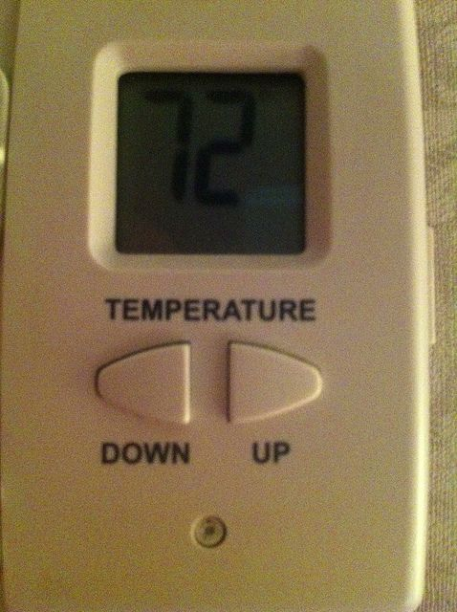

Bad UX

Slide 5

What is ONE.UF?
Exceptional UX

Slide 6

What is ONE.UF?
User Experience Platform
Self service
One stop shop
Integrated apps
Mobile first
Device agnostic

Slide 7
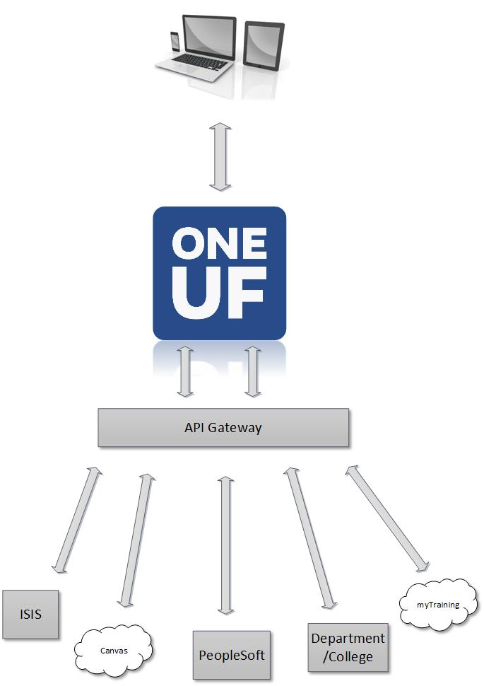

Slide 8

What is ONE.UF?
Notifications
Modular
Workspaces
Search
Preferences
Personalization
Communications

Slide 9
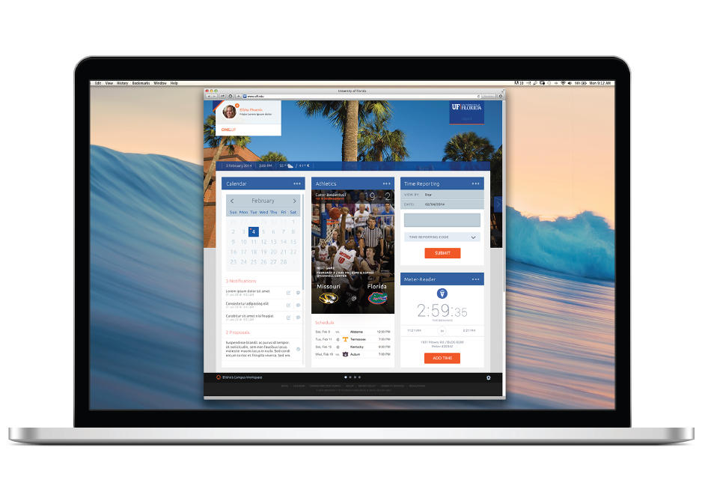

Slide 10
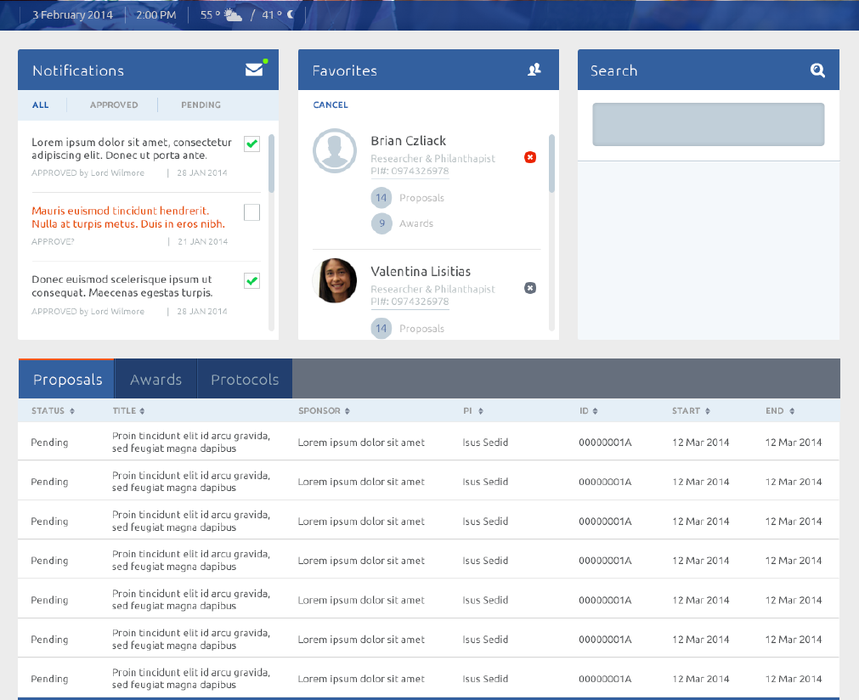

Slide 11
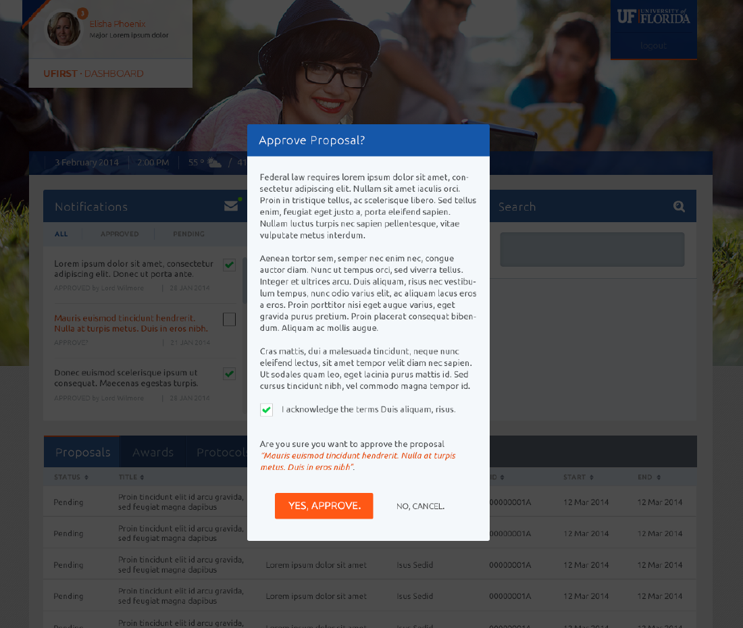

Slide 12
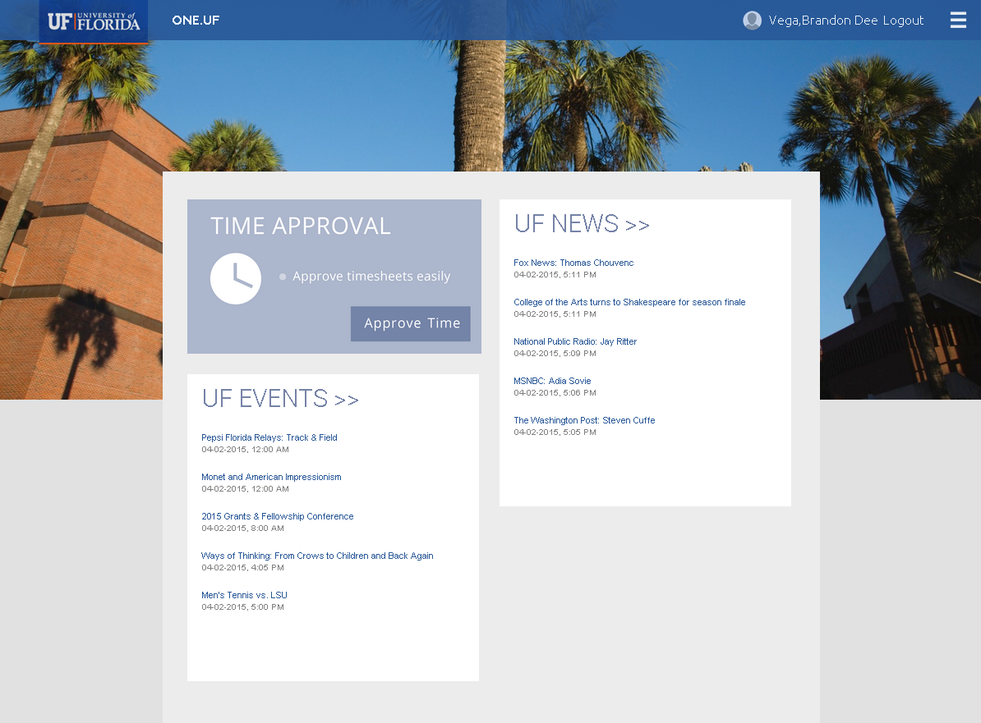
Current State
Dashboard
Time Approvals
News
Events
Schedule of Courses
myIT

Slide 14
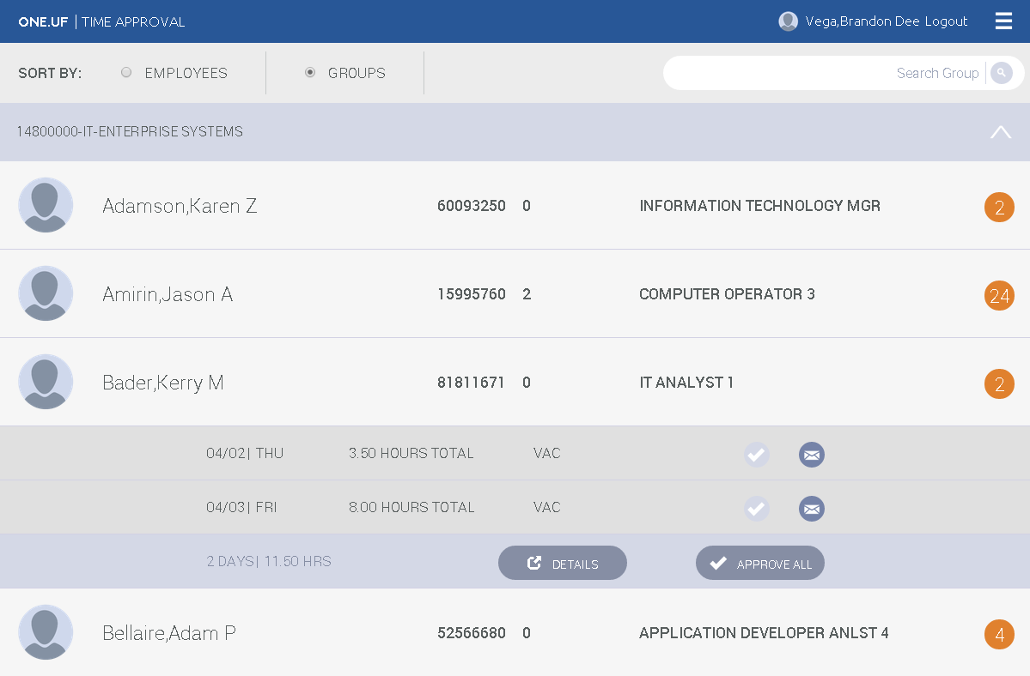

Slide 15
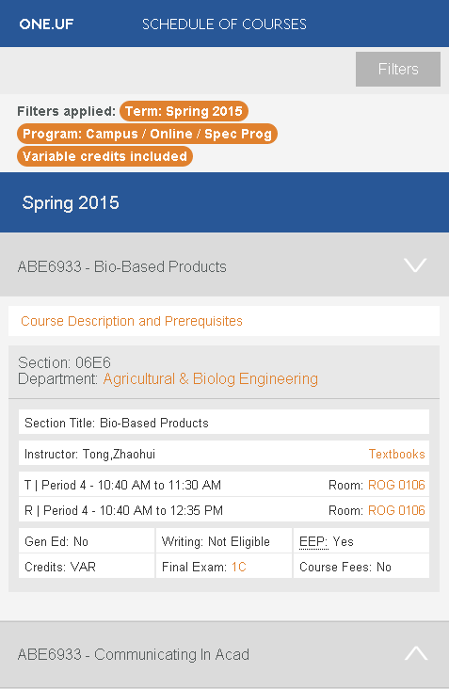

Slide 16
Future
2014
Dec
Feb
2015
Apr
Jun
Aug
Oct
Dec
2015
Today
Schedule of Courses
119 days
Dec 2 - May 15
MyIT
54 days
Feb 16 - Apr 30
Notifications, Preferences, Personalization
66 days
Apr 1 - Jul 1
Registration
75 days
Apr 20 - Aug 1
Degree Audit
58 days
Jul 14 - Oct 1
My Schedule
65 days
Aug 1 - Nov 1
At a Glance View
66 days
Sep 1 - Dec 1

Slide 17
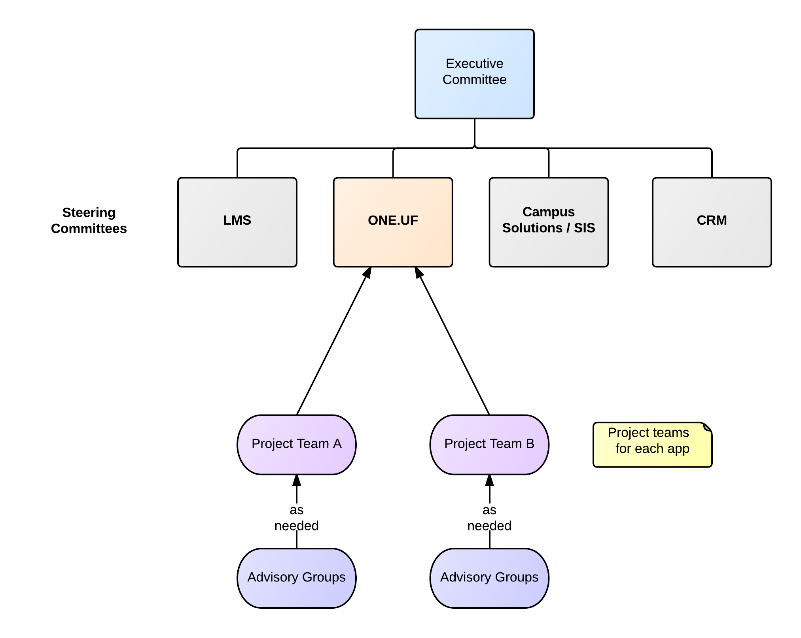
Governance

Slide 18
Governance
Steering Committee makes decisions related to:
Priorities
Roadmap
Communications
Potential Blockers
Project Scope
Budget

Slide 19
Demonstration

Slide 20
Questions?
Brandon Vega
brandonvega@ufl.edu
Jacob Prater
jacobp@ufl.edu

