Slide 1



IT Peer to Peer Program Review
April 9, 2015

Slide 2


What is PrintSmart?
New contract includes use of equipment, maintenance & supplies (except paper)
Program savings go back to the department level
No need to lease or purchase equipment anymore
Departments pays Cost Per Impression rate of Monochrome: $0.0137 Color: $0.0470
Devices include: 8 models of Multi-Functional-Devices (MFD) / 2 Workgroup printers
Each machine will be networked which will enable Xerox to
monitor internal alerts on equipment and dispatch technicians
monitor toner levels and dispatch supplies automatically
poll monthly meter readings automatically
Contract includes a Service Level Agreement (SLA) to ensure consistent servicing of fleet.
Includes a dedicated PrintSmart helpdesk via toll free number
On site Managed Print Program Manager – Eric Gibbs; Dedicated On-site Service Technician

Slide 3
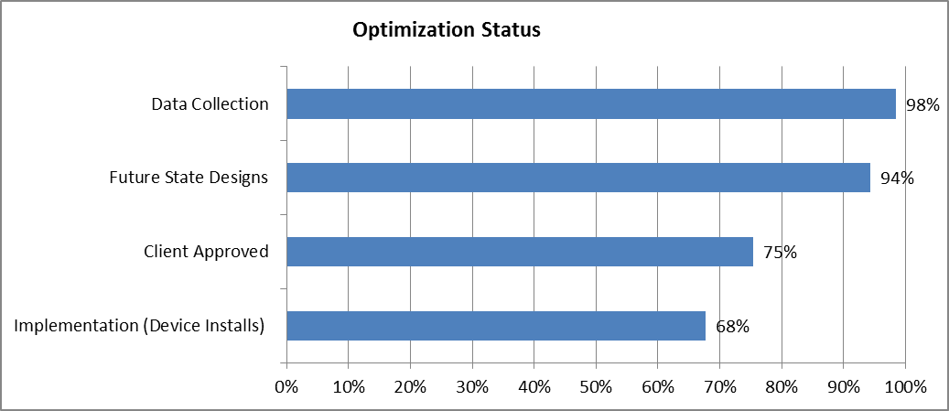

Project to Date Summary
As of 03/31/15
New Device Installs through April 1, 2015– 1,024
Total projected savings to date for approved designs - $125K per month
or $1,500M/ year*
* Assumes all approved volume is moved to PrintSmart devices

Slide 4
Standards of Performance Scorecard February 2015
Performance Criteria | Standards of Performance | Current Performance | Performance Trend | Key Messages / Action Taken
Average Break/Fix Response Time 4 hours | The average amount of time between the client initiated call and the arrival of the service technician on site. | 94.6% |  | Avg response time 3.48 hrs
Equipment Uptime 98% | The three month rolling percentage that the equipment is available for use within the contracted period of coverage. | 99.85% |  | 243-break/fix incidents 27.6% reactive
First Time Fix 85% | The average number of times a device was successfully repaired during the initial call. | 91.7% |  | 223 out of 243 reactive service incidents resolved on first call.
Notes:
No Yellow – We are either achieving SLA’s or Not
Share SLA’s with Associates
Hints & Tips:
Customize these according to contracted Standards Of Performance (SOP) / Service Level Agreements (SLA) not Statement of Work (SOW)
Consider discussing the differences in Standards of Performance / Statements of Work / Service Level Agreements

Slide 5
Lessons Learned/Process Improvements
Standard Security Configuration
Pre Implementation Local IT call
Review department specific deployment
Time line
Infrastructure (network drops, fax lines)
Print Server/ Print Driver discussion
VLAN requirements / MAC addresses (provided in advance)

Slide 6
Lessons Learned/Process Improvements
Device Removals
Removals occurring/staying on day of install identified prior to implementation
UF Purchasing Resource Focal for supporting departments with removal process
Engage IT for device moves/removals to clear the queue
Consolidation of IT Documents/Document Sharing
Best practices shared during pre implementation planning
Document Wiki in process
PrintSmart Listserv – subscribe “
Website revamp
Toner Recycle initiative

Slide 7
Lessons Learned/Process Improvements
Printing Challenges
Device specific print drivers may be best for deployment
Mainframe printing concerns addressed
Addressed issues with printing from Apple computers
Working with Dept. IT on Linux printing challenges
Steady State
Leave devices on at all times
Supplies should not be replaced until completely out (or alert may not trigger).
Please inform Eric Gibbs if IP, password or any other data changes.
Key device contacts change frequently which can create confusion with supplies as they ship to this persons attention.

Slide 8
Q&A

