Slide 1
Recording Videoconferences
Video & Collaboration Services
Abraham Turell, CTS

Slide 2
Cisco TelePresence Content Server
Overview
Basic recording option for UF’s videoconferencing bridging service
Captures participants and content in single video stream
Use it to record…
Lectures
Training Sessions
Meeting/Conferences
Events
Publish, store or share

Slide 3

Cisco TelePresence Content Server
How to set a videoconference to record?
After creating the VC bridge…
Regular users – forward confirmation email to VCS with request to record
IT Rep’s – access thru TMS Admin portal
Send access request to VCS
How does it record?
Join’s conference as a participant
Picks up any audio/video as one stream

Slide 4

Cisco TelePresence Content Server
Format?
“Stacked” default display format when sharing content
The TCS records only in WMV
Can be transcoded to MP4 in Mediasite
By request only
How are videos accessible?
Videos are imported to Mediasite for On-Demand viewing
Typically 15-30 minutes after conference ends
Videos drop into the public VC folder or as requested
Cost?
Free service

Slide 5
Cisco TelePresence Content Server
Pro’s
Easy set-up
Publishes to Mediasite catalogue
Basic video editing
No additional equipment needed (besides VC unit)
Con’s
Not a live streaming service
VCS only monitors connectivity, no audio or video
Does not record Rich-Media
Vs. Mediasite recorder

Slide 6
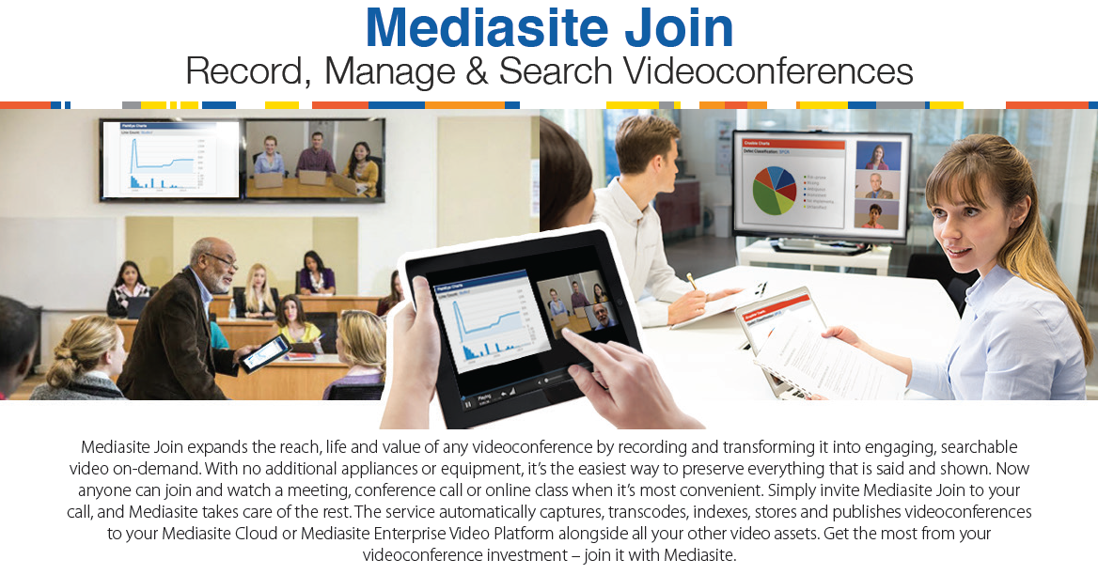
Mediasite Join
Proposed replacement
Added features…
Interactive, Dual-stream content
Rich-Media
Collaborative video editing

Slide 7

Questions

Slide 8
Video & Collaboration Services
Contact us
Phone: 352-392-HELP (4357)
Web: http://video.ufl.edu
Email: video@ufl.edu

